Slide 1
Noncoding RNAs
Christopher Maher
Associate Professor, Internal Medicine and Biomedical Engineering
Washington University School of Medicine
November 10th, 2022
CSHL Advanced Sequencing Technologies & Bioinformatics Analysis Course

Slide 2
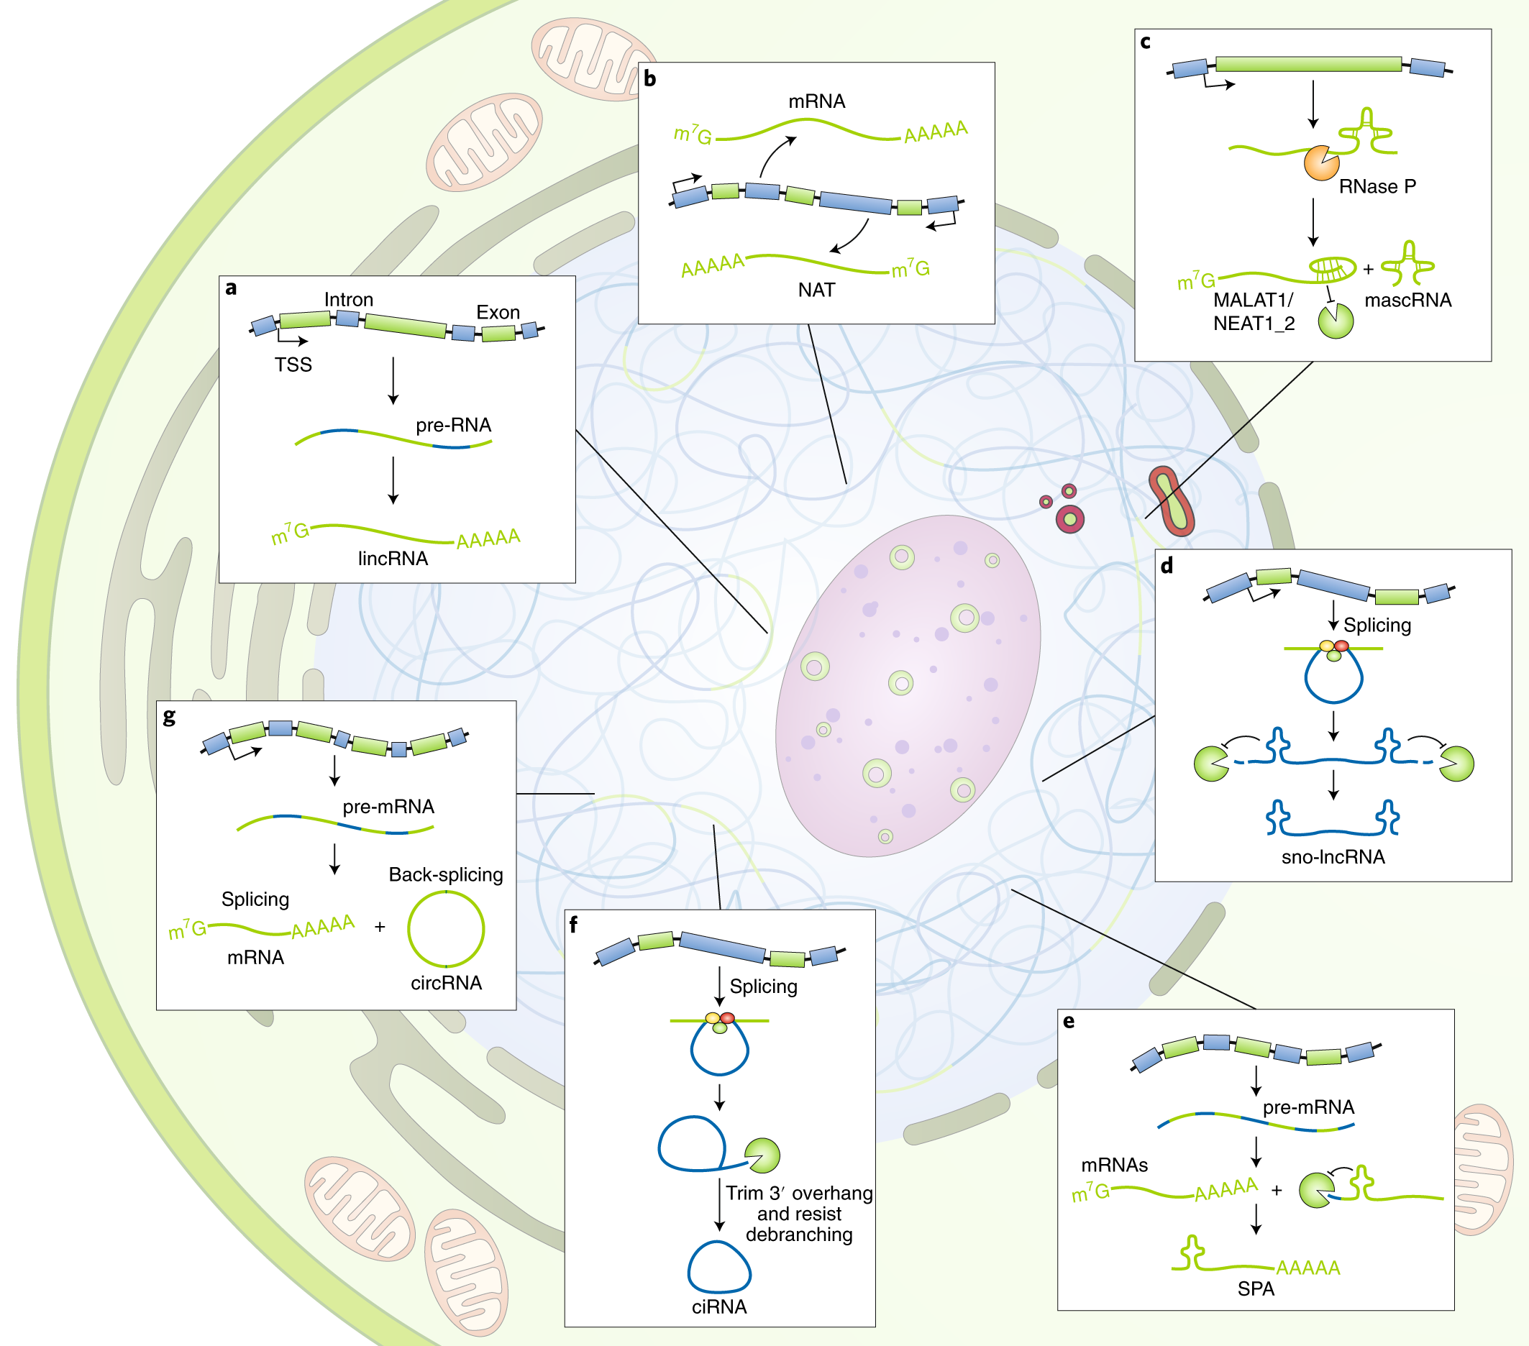
Diversity of noncoding RNAs

Slide 3
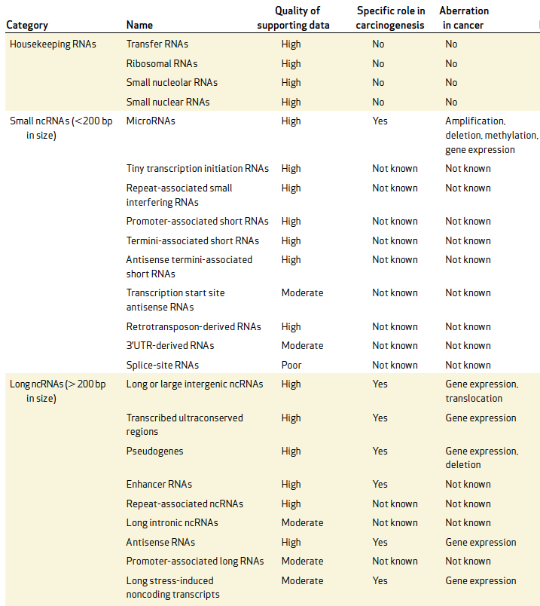
Classes of non-coding RNAs
Existing small noncoding RNA analysis tools are optimized for processing short sequencing reads (17-35 nucleotides) to monitor microRNA expression.
These strategies under-represent many biologically relevant classes of small noncoding RNAs in the 36-200 nucleotides length range (tRNAs, snoRNAs, etc.)
(Cancer Discovery - Prensner et al., 2011)

Slide 4
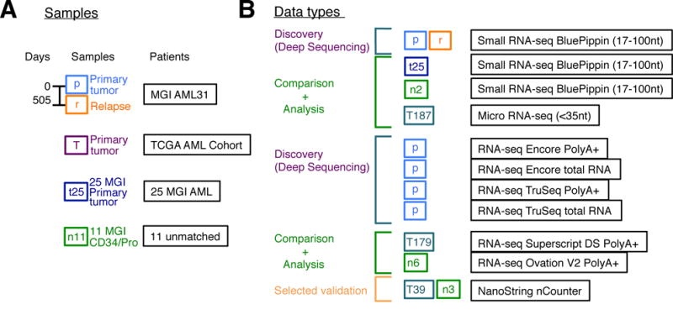
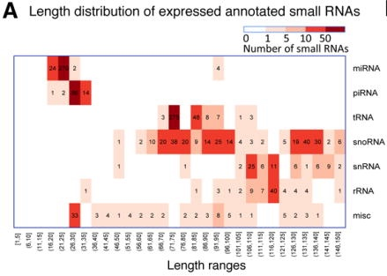
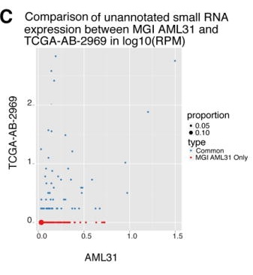
Discovered previously unannotated small RNAs using deep sequencing of a libraries with broader insert size selection
Existing small RNA analysis tools were not intended to analyze sequence reads of varying lengths, handle larger quantities of sequence reads, or support for diverse small RNA species
(Zhang et al., 2017)

Slide 5
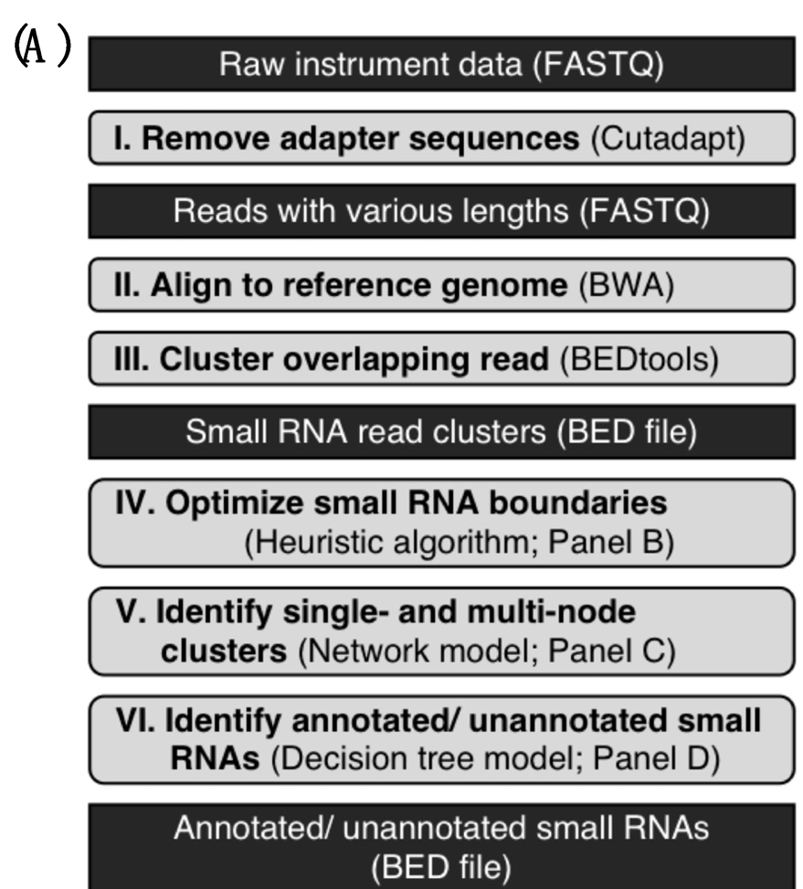
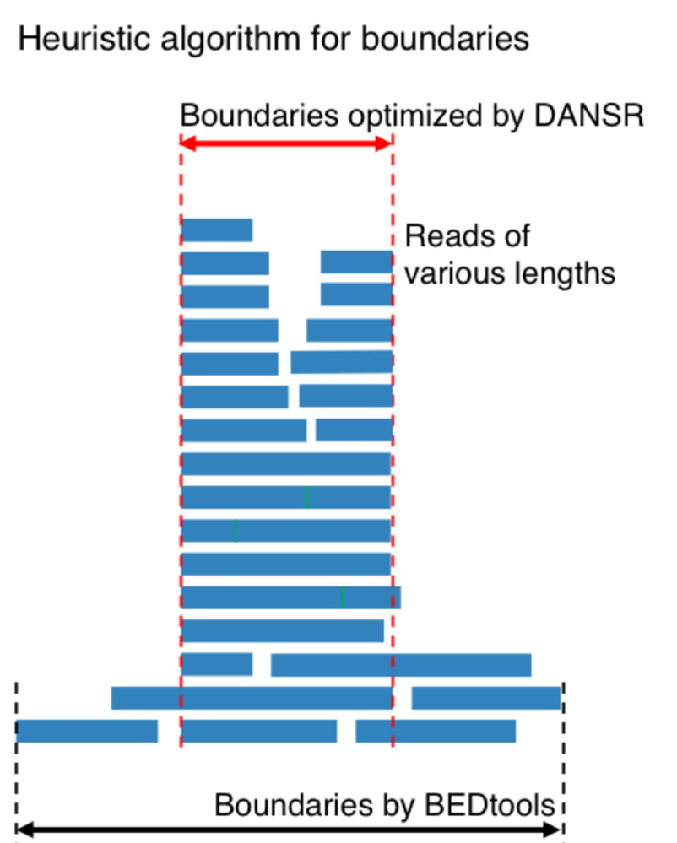
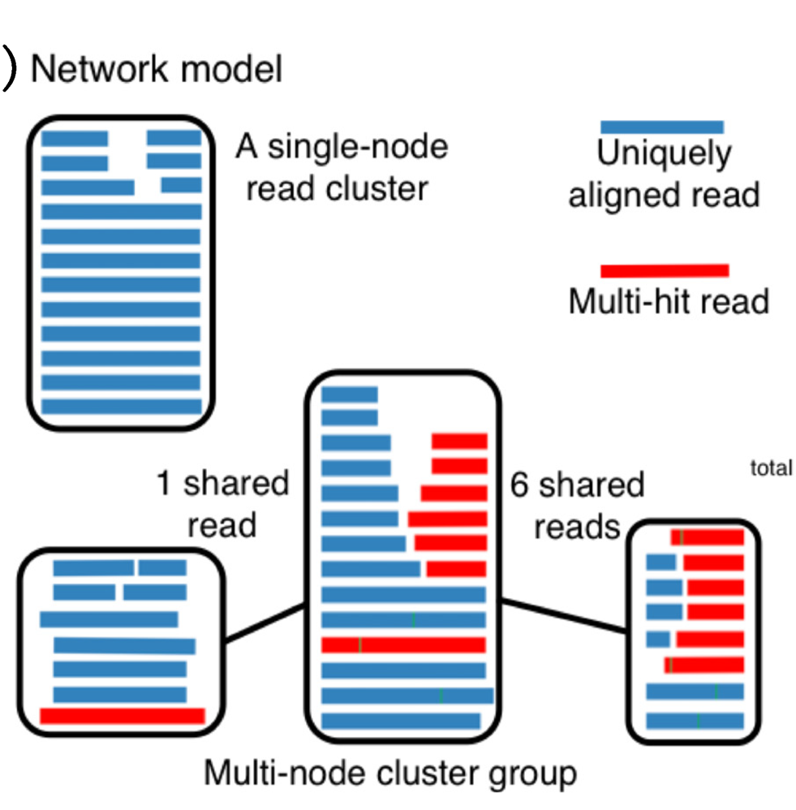
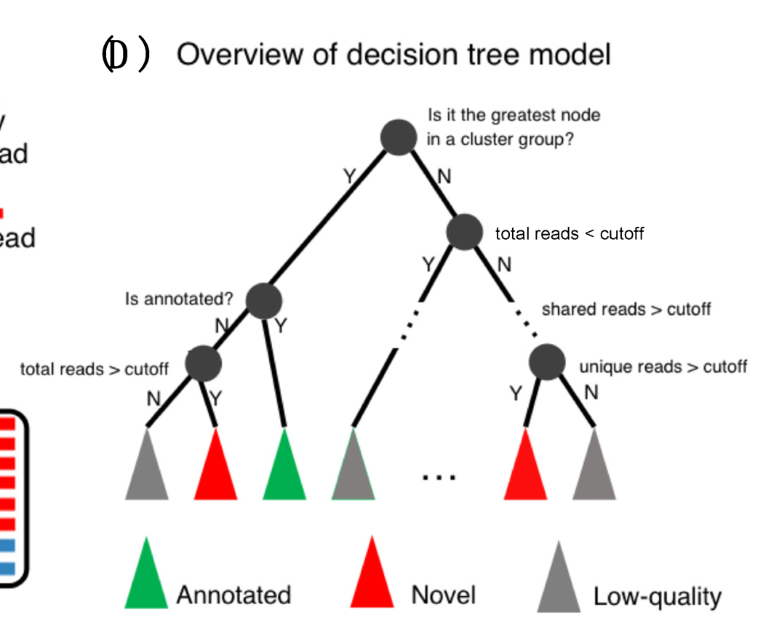
DANSR: A Tool for the Detection of Annotated and Novel Small RNAs
https://github.com/ChrisMaherLab/DANSR
(Eteleeb et al., 2022)
Notes:
4.3. Optimize Small RNA Boundaries
In the fourth step, a heuristic algorithm is employed to optimize the boundaries of each
read cluster identified in the third step to more accurately define the range of the small RNA
cluster and split it into sub-clusters if it represents more than one feature. (Figures 1B and S2).
This algorithm works by assigning a weight to each read based on the level of its contribution
to the original cluster. The read weight is computed by first walking through the cluster
bases and computing the read depth of each base (number of reads covering the base). An
individual read’s weight is defined as the total coverage of the bases it spans divided by the
read length. Thus, if p represents the position of the ith base in a read of length n, the read
weight can be represented by the following equation:
Rw =
ån
1 cov (pi)
n
(1)
where cov = total number of reads covering the base.
Once all read weights are computed, reads within the cluster are ordered by weight,
and a number of the lowest-weight reads equal to a proportion of the total number of
reads (defined by the percent-cur parameter, default 0.3) in the original cluster, designated
H0, are provisionally removed. The updated cluster (H1) is then split into sub-clusters,
each of which starts at a transition from 0 read coverage to coverage > 0 and ends at a
transition from coverage > 0 to 0. H0 is also subdivided into sections at the midpoint of
each gap between sub-clusters in H1. For each candidate sub-cluster, the average coverage
depth is compared to that of the corresponding section of H0. If the ratio of coverage
depths W(H0)/W(H1) > (1 + cutoff), where cutoff is the input parameter (default 0.3),
the reads and boundaries of the new sub-cluster in H1 are accepted; otherwise, the initial
cluster reads and boundary from the corresponding section of H0 are retained. Consecutive
retained sections of H0 are merged into single clusters. Figure S2 shows a sketch illustrating
this process.
4.4. Identify Single- and Multi-Node Clusters
In the fifth step, a network model is built based on uniquely aligned and multi-mapped
reads to identify single-node read clusters and multi-node read clusters (i.e., a group of
clusters that share multiply-aligned reads between them) (Figure 1C), which are used in the
next step to identify low quality clusters caused by repetitive reads. The network consists
of a graph in which nodes represent clusters and edges represent the shared reads between
clusters. Thus, if a cluster is comprised of only uniquely mapped reads, the cluster is called
a single-node cluster. All single-node clusters are reported as results and do not need to
be processed by the decision tree model in the sixth step. In its general construction, the
network is a graph consisting of a large number of subnetworks. To assess the quality of
the clusters, all multi-node clusters are subjected to a quality check in the next step.
Each node of the network is a cluster of read alignments, and two nodes are connected
by a link if >50% of the alignments from at least one node have a hit in the other node. Fully
connected sub-networks come in two shapes: star-like and clique. A star-like sub-network
represents the case in which a central small RNA node generates false positive read clusters
at multiple locations, which are difficult to filter in the absence of network analysis. A
clique shape represents a small non-coding RNA that has multiple copies on the human
genome. The network analysis ensures that, on the one hand, no copy of the same small
non-coding RNA is missed and, on the other hand, that the expression level of the small
non-coding RNA is calculated accurately by including reads from repetitive small RNAs
only once.
At the same time as each cluster is processed by the network model, it is annotated
using a human reference annotation and one or more small RNA annotation sets (all in GTF
format). DANSR provides a GRCh38/hg38 small RNA library that includes annotations
for >187 k features and is sourced from RNAcentral [20]. A curated GRCh37/hg19 small
noncoding library collected from multiple resources by our team to cover any small RNA
genes missing from the standard human genome annotation in a prior study [8] is also
provided; users may employ either annotation file or provide their own. Clusters that
overlap one or more features in the provided annotation files are provisionally annotated
with each of those features.

Slide 6
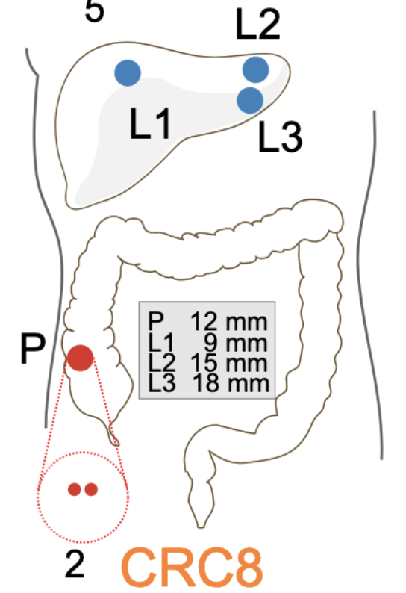
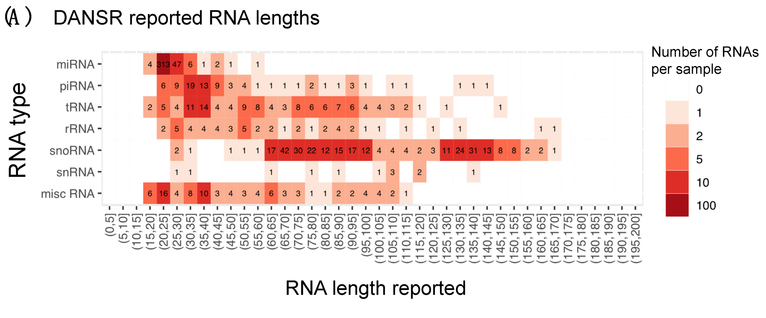
Accurate categorization of annotated small RNAs in metastatic colorectal cancer (mCRC) patients
https://github.com/ChrisMaherLab/DANSR
(Eteleeb et al., 2022)

Slide 7
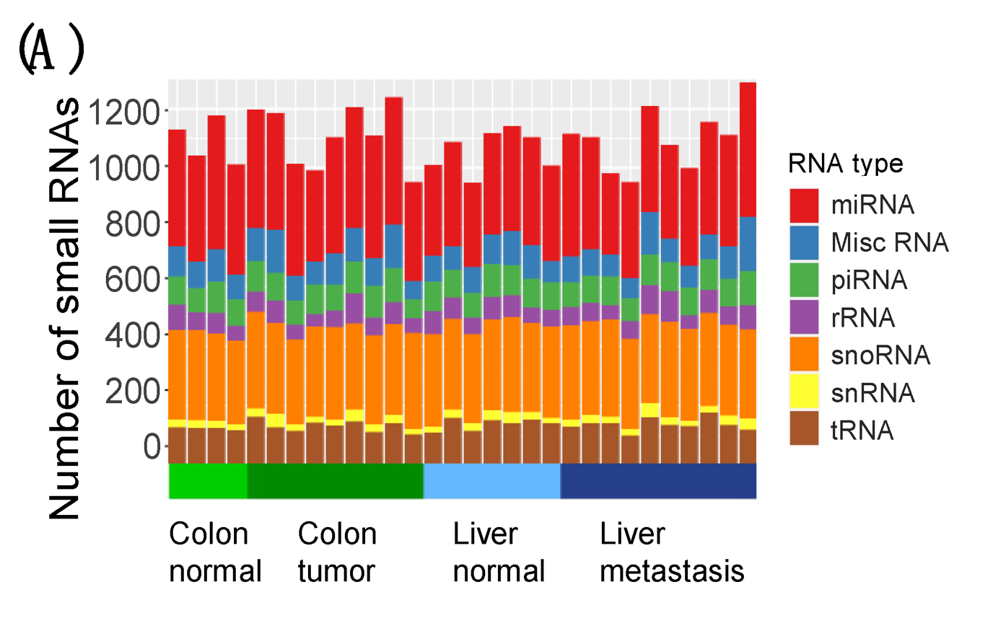
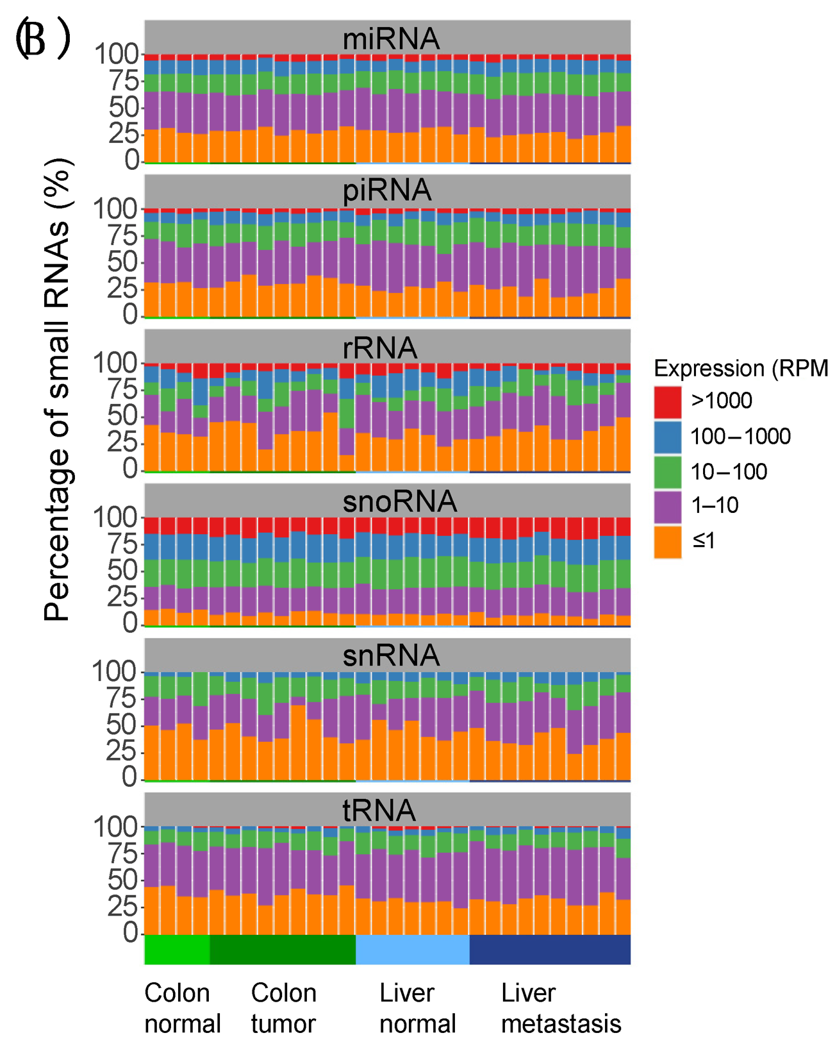
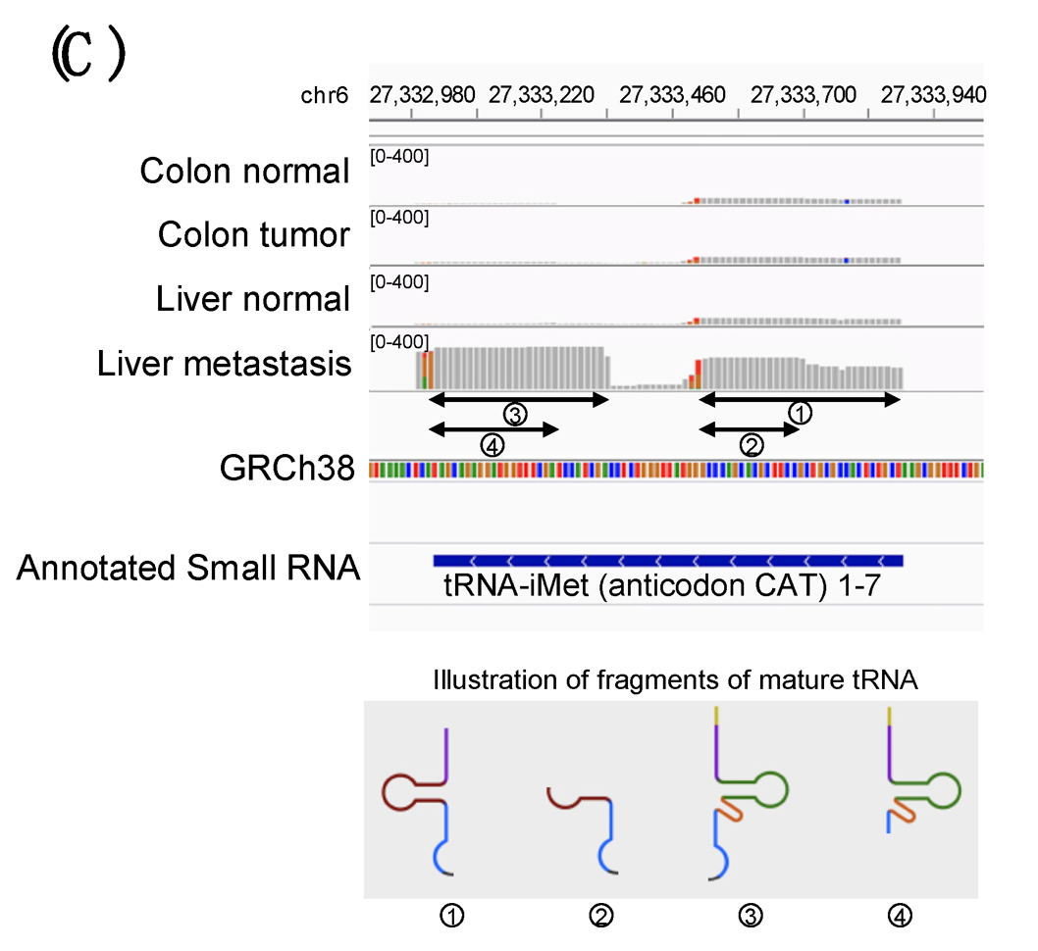
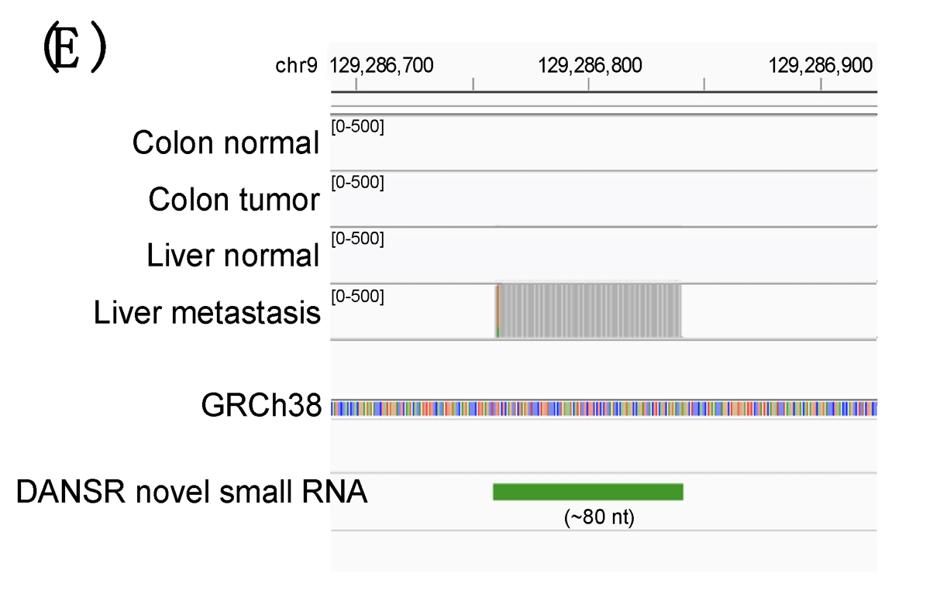
Discovery of altered small RNAs in metastatic colon cancer progression
https://github.com/ChrisMaherLab/DANSR
(Eteleeb et al., 2022)

Slide 8
Long noncoding RNAs (lncRNAs)

Slide 9
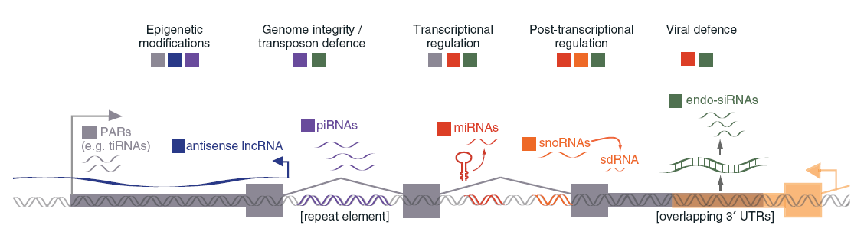
Characteristics of long non-coding RNAs (lncRNAs)
Transcription via RNA polymerase II
Polyadenylation
Frequent splicing of multiple exons via canonical genomic splice site motifs
Regulation by well-established transcription factors
Epigenetic marks consistent with a transcribed gene (H3K4me3 at the gene promoter, H3K36me3 throughout the gene body)
Frequent expression in a tissue-specific manner

Slide 10
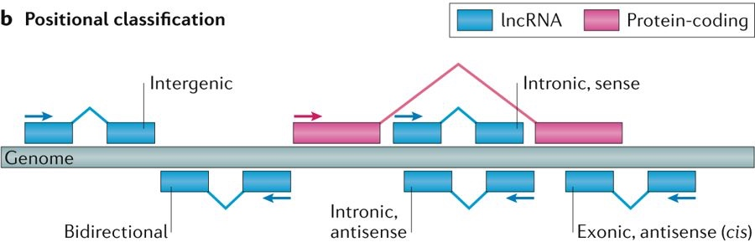
Positional classification of lncRNAs
Notes:
a | The principal structures of a long non-coding RNA (lncRNA) to be annotated. Annotations are hierarchical: they are composed of gene loci, each of which is composed of one or more partially overlapping transcripts, themselves composed of one or more exons (blue rectangles). b | Positional classification of lncRNAs with respect to the nearest protein-coding gene. Genic lncRNAs overlap a protein-coding gene locus, whereas intergenic lncRNAs, also known as long intergenic non-coding RNAs (lincRNAs), do not. Transcripts that overlap a protein-coding gene on the opposite strand are identified as antisense. PAS, polyadenylation site; TSS, transcription start site.

Slide 11
Integrative methods for discovering lncRNAs

Slide 12
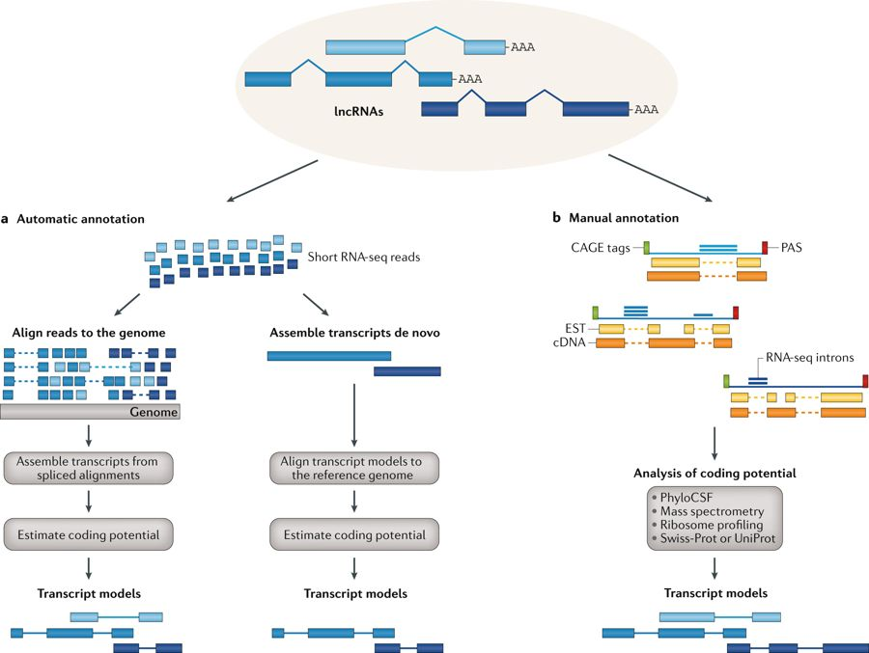
RNA-Seq focused strategies for lncRNA discovery
(Cell -- Bartel et al., 2013)
(Uszczynska-Ratajczak et a., 2018)
Notes:
To address the first challenge, we took an entirely different approach to discovering functional lincRNAs on the basis of exploiting chro- matin structure. We recently developed an efficient method14 to create genome-wide chromatin-state maps, using chromatin immunopreci- pitation followed by massively parallel sequencing (ChIP-Seq). We observed that genes actively transcribed by RNA polymerase II (Pol II) are marked by trimethylation of lysine 4 of histone H3 (H3K4me3) at their promoter and trimethylation of lysine36 of histone H3 (H3K36me3) along the length of the transcribed region14. We will refer to this distinctive structure as a ‘K4–K36 domain’. We proposed that, by identifying K4–K36 structures that reside outside known protein- coding gene loci, we could systematically discover lincRNAs.

Slide 13
How many lncRNAs have been annotated
Comprehensiveness
The fraction of all gene
loci that are included;
Exhaustiveness
The fraction of all transcripts from each locus that are known;
Completeness
The fraction of transcript models that
cover the entire length, from start to end, of the physical
RNA molecule
(Uszczynska-Ratajczak et al., 2018)

Slide 14
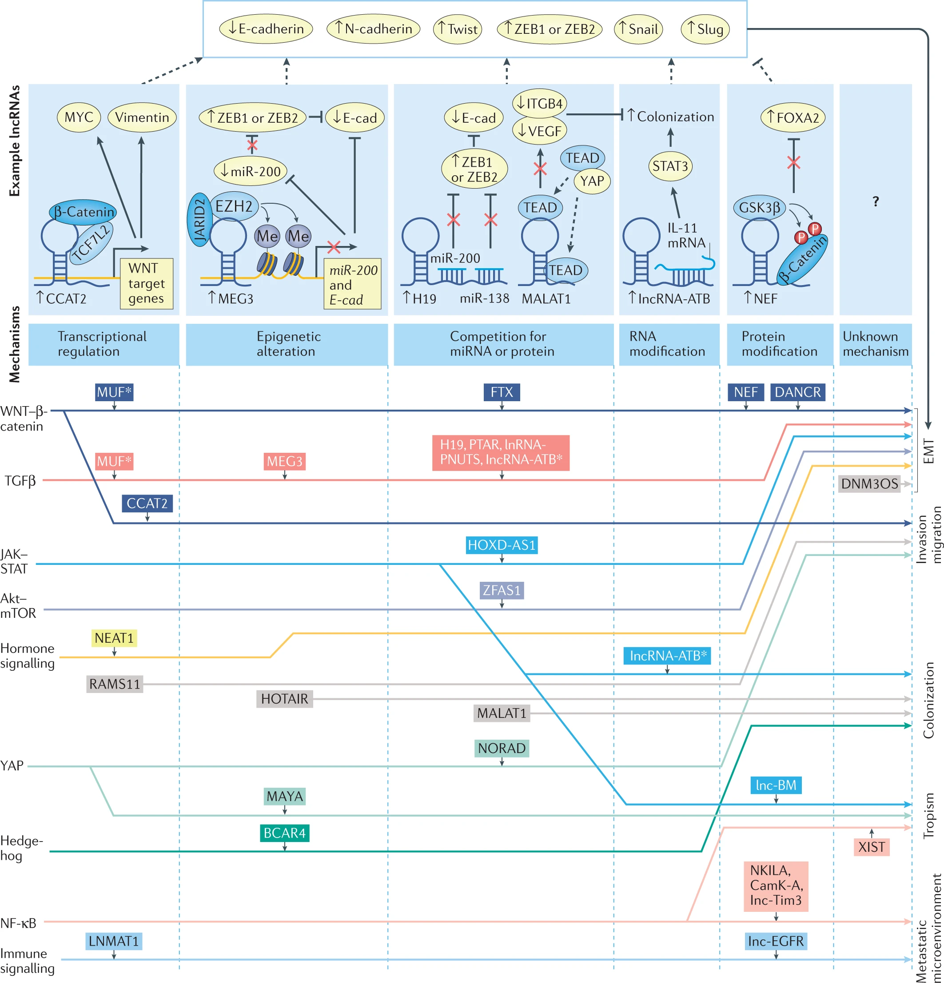
Long noncoding RNAs regulate metastasis via various pathways using diverse mechanisms
(Nature Reviews Cancer
Liu et al., 2021)

Slide 15
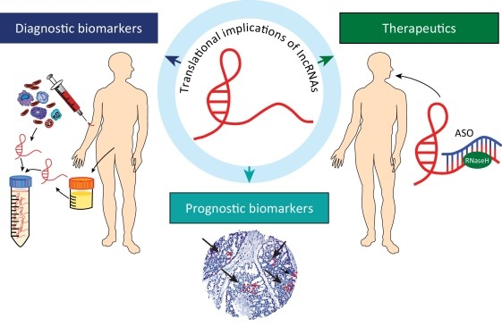
Clinical applications of lncRNAs
(White et al., 2017)
LncRNAs are emerging as diagnostic/prognostic biomarkers in tissue, serum, and urine
Antisense oligonucleotides (ASOs) can be used to directly target lncRNAs and are a promising therapeutic strategy in cancer
Notes:
Translational Implications of lncRNAs. Long noncoding RNAs (lncRNAs) are emerging as both diagnostic and prognostic biomarkers that can be detected in tissue, serum, and urine. Antisense oligonucleotides (ASOs) can be used to directly target lncRNAs and are a promising therapeutic strategy in cancer.

Slide 16
Despite discovering thousands of lncRNAs, only a minor subset have been well characterized
Challenges:
Prioritizing biologically and clinically relevant lncRNAs
Lack of “domains” is a barrier for predicting function
Molecular interrogation is labor intensive
(Nature Reviews Cancer Liu et al., 2021)

Slide 17
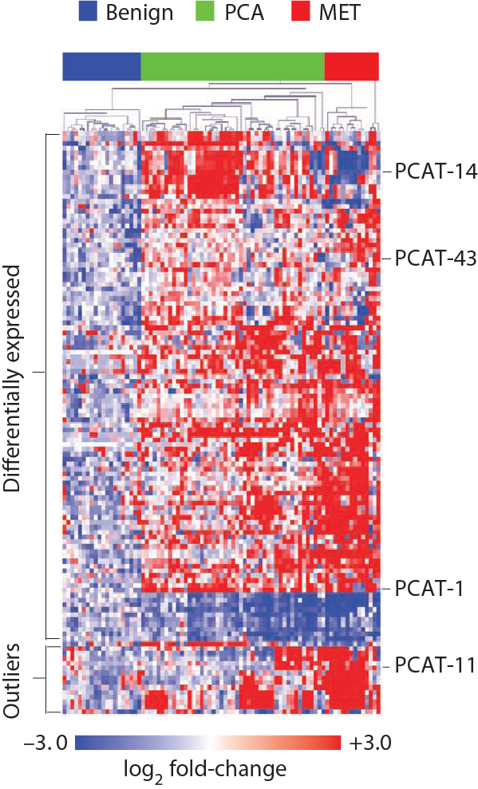
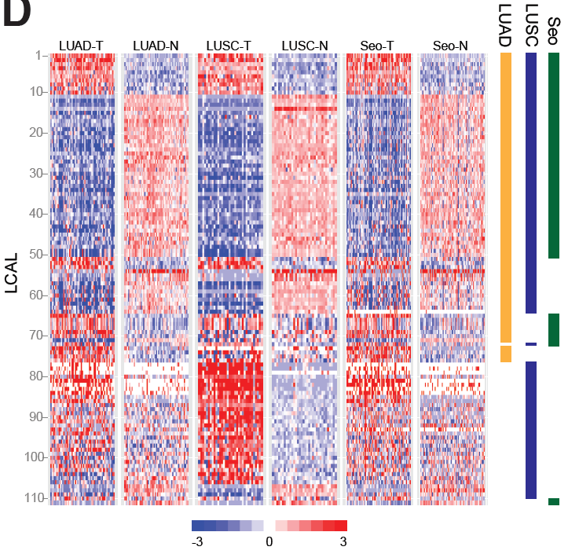
Only a fraction of lncRNAs are altered in a given cancer type
RAMS11
Analysis 121 prostate cancer patients (normal, primary, and metastatic samples)
In total, we identified 121 prostate cancer associated transcripts (PCATs)
Analysis of ~600 LUAD and LUSC cancer patients
111 novel transcripts were differentially expressed in at least one histology
Referred to as lung cancer associated lncRNAs (LCALs)
148 lncRNAs that performed as well as known biomarkers in differentiating benign, primary, and metastatic tissues
51 lncRNAs differentially expressed in metastatic tumors compared to non-metastatic (primary and adjacent normal)
17 Unannotated
Referred to as RNAs Associated with Metastasis (RAMS)
(Nature Biotechnology-- Prensner et al., 2011)
(Genome Biology -- White et al., 2014)
(Nature Communications –Silva et al., 2021)

Slide 18
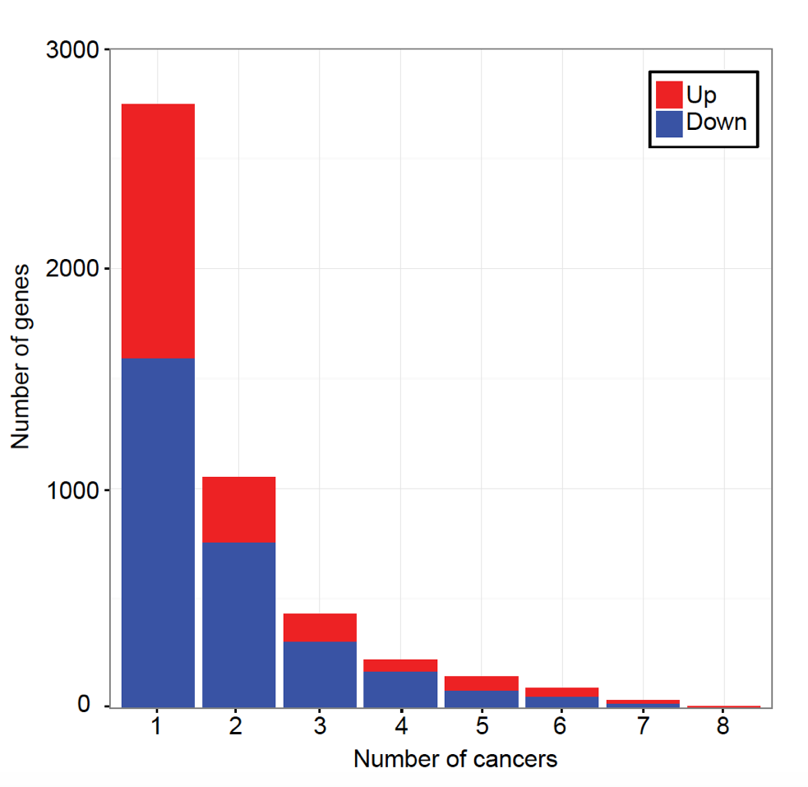
LncRNAs have greater tissue-specificity in pan-cancer analysis across ~3,000 patients
Differentially expressed protein-coding genes
~10% of protein-coding genes are altered across 2 or more cancer types
~2% of lncRNAs are altered across 2 or more cancer types
(Cabanski et al., 2015)

Slide 19
PCAT-14 expression is enriched in prostate cancer
(European Urology -- White et al., 2017)

Slide 20
PCAT-14 as a single gene predictor of aggressive disease
(European Urology -- White et al., 2017)

Slide 21
Long noncoding RNAs and the tumor microenvironment
(Nature Reviews Cancer Liu et al., 2021)

Slide 22
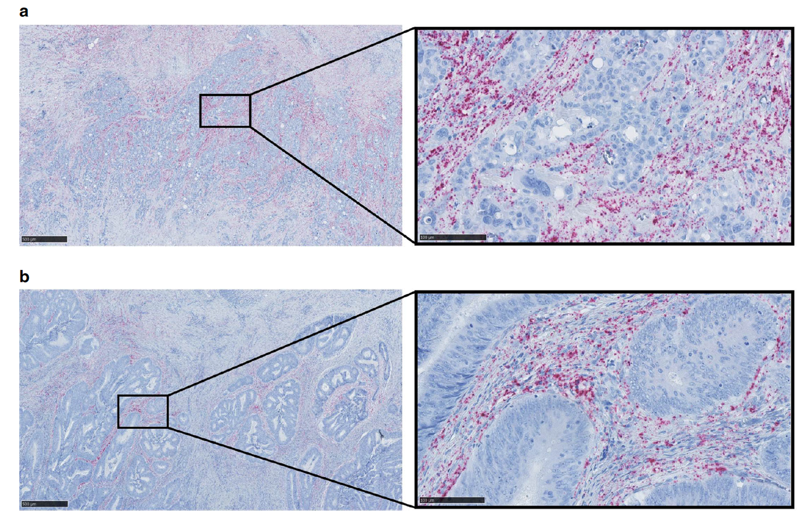
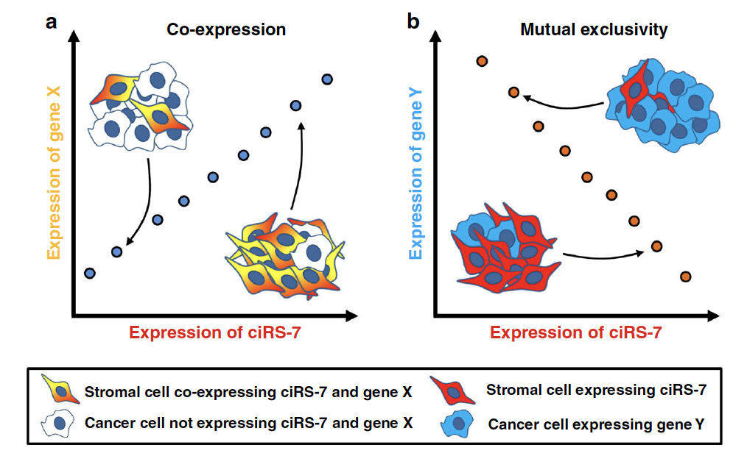
Challenge to the miRNA sponge mechanism
Poorly differentiated CRC
Well differentiated CRC
Stromal cells:
ciRS-7 √
miR-7 ×
Cancer cells:
ciRS-7 ×
miR-7 √
(Kristensen, L.S., et al., 2020)
Notes:
specific RNA chromogenic in situ hybridization (CISH) assay for spatial visualization of ciRS-7 expression on 16 patients + tissue microarrays (TMA) on 47 patients + laser capture microdissection (LCMD) of cancer and stromal cells from 4+4 representative patient samples and analyzed the pools of cells separately using NanoString nCounter.

Slide 23
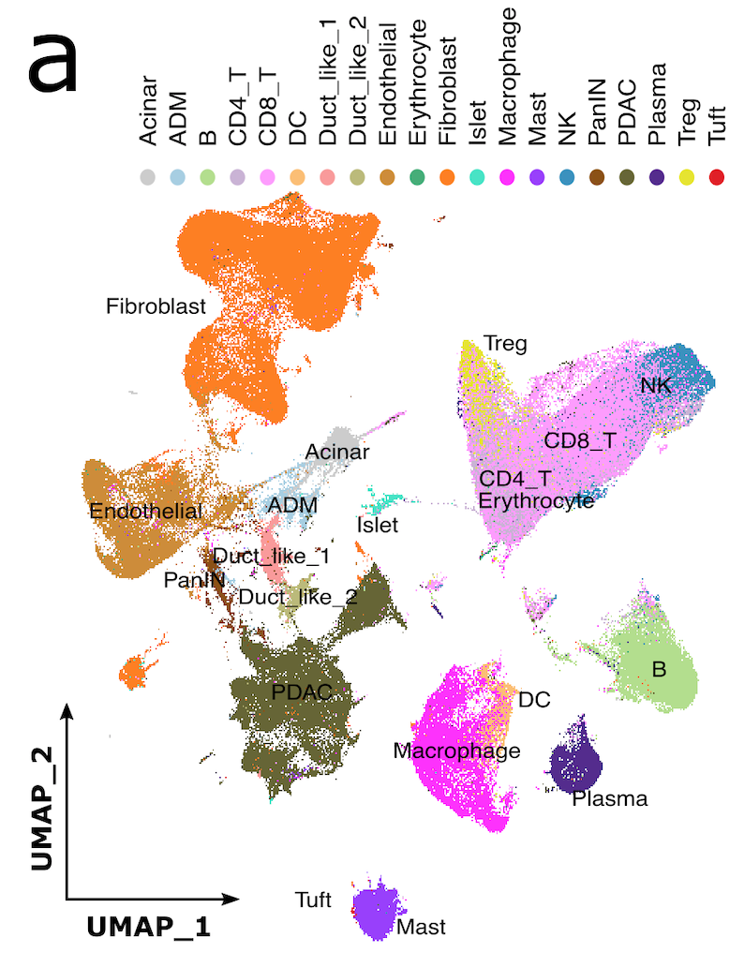
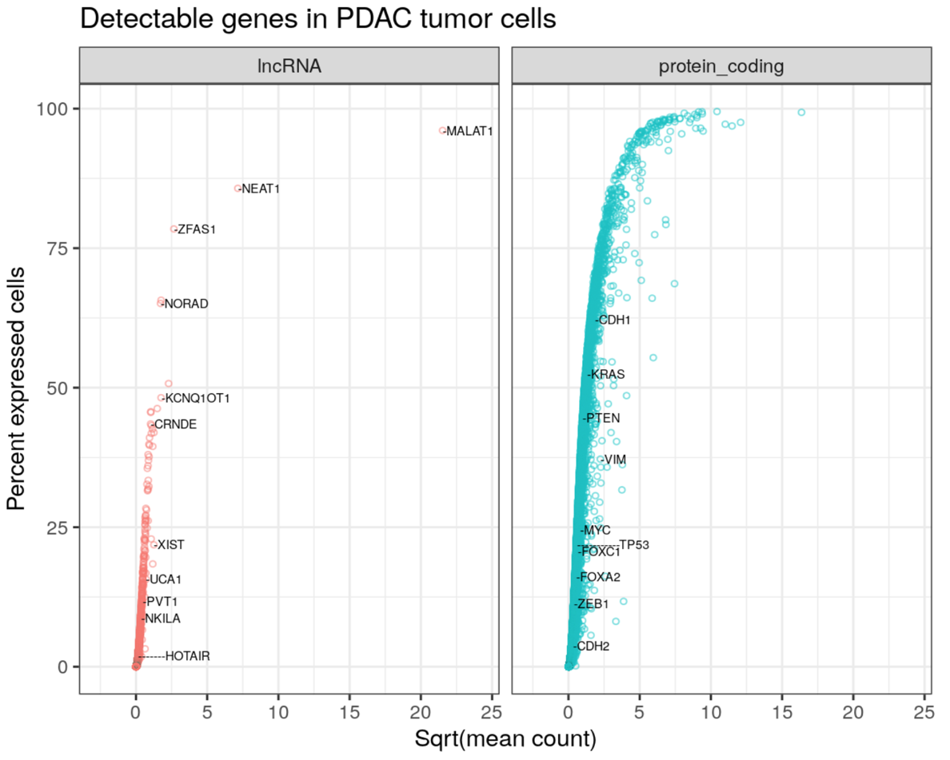
Analysis of lncRNAs in single cell RNA-Seq data from pancreatic cancer patients
73 samples from 21 patients with PDAC
10x Genomics scRNA-Seq data (~50K reads per cell)
Various cell types identified in TME including PDAC tumors, immune cells, and stromal cells
Most genes are only detected in a small fraction of cells
LncRNAs are more likely to be missed at individual cell level due to their lower expression level
Significant number of lncRNAs are detected in as many cells as protein coding cancer genes

Slide 24
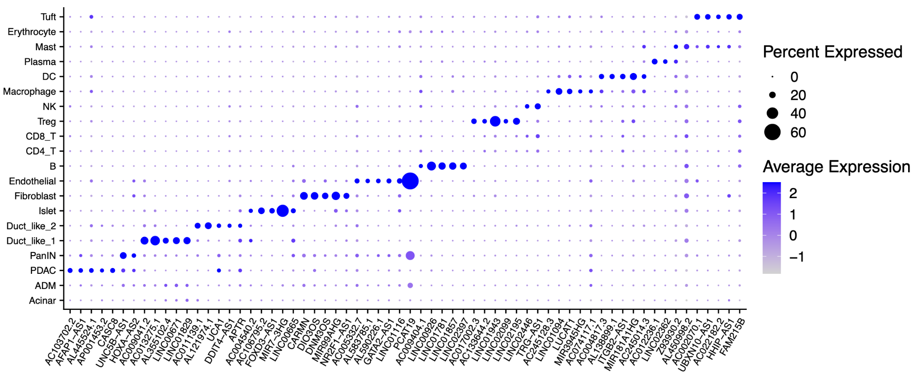
LncRNAs as markers of PDAC TME cell types
PCAT19 in endothelial cell

Slide 25
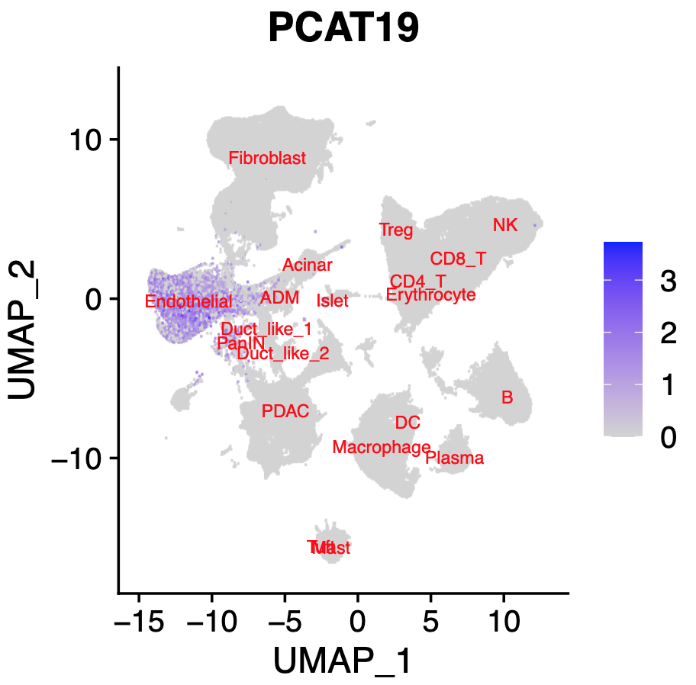
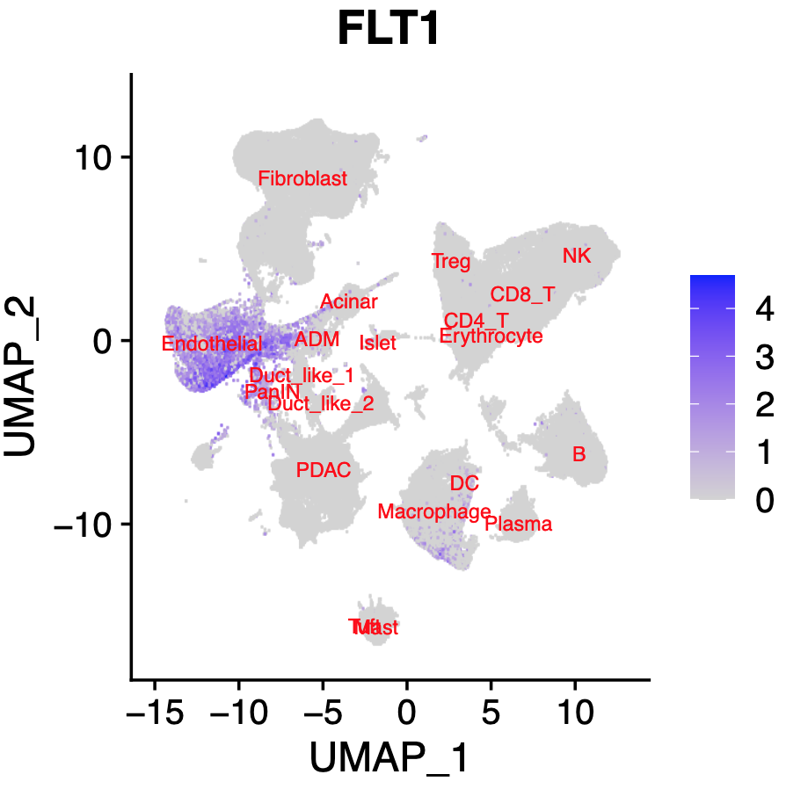
PCAT19: a strong marker of endothelial cells

Slide 26
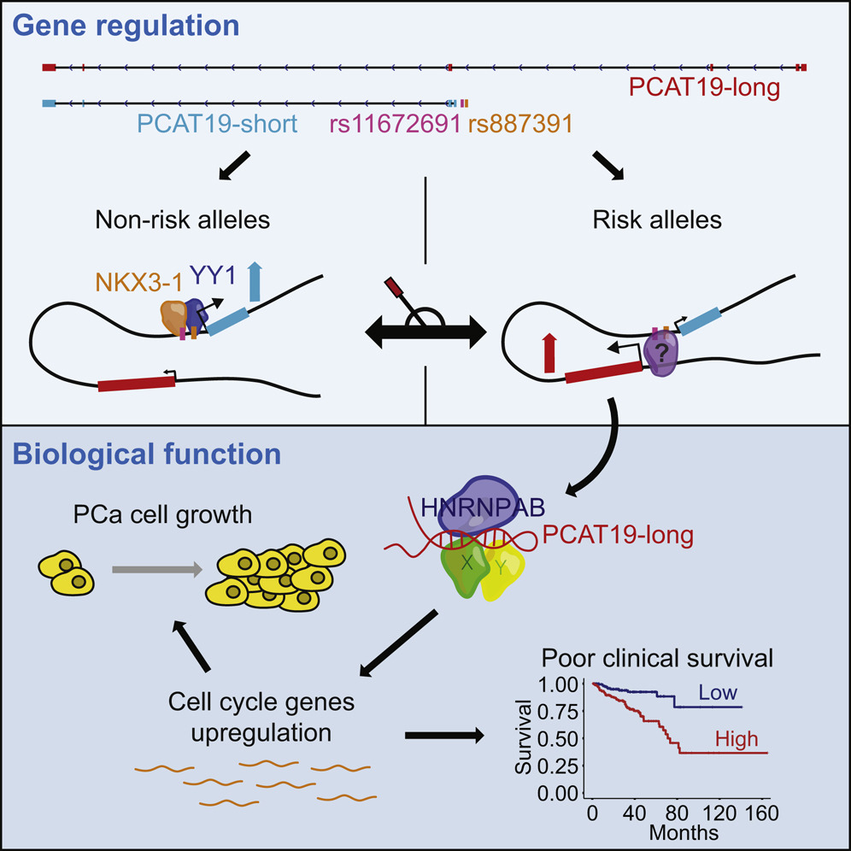
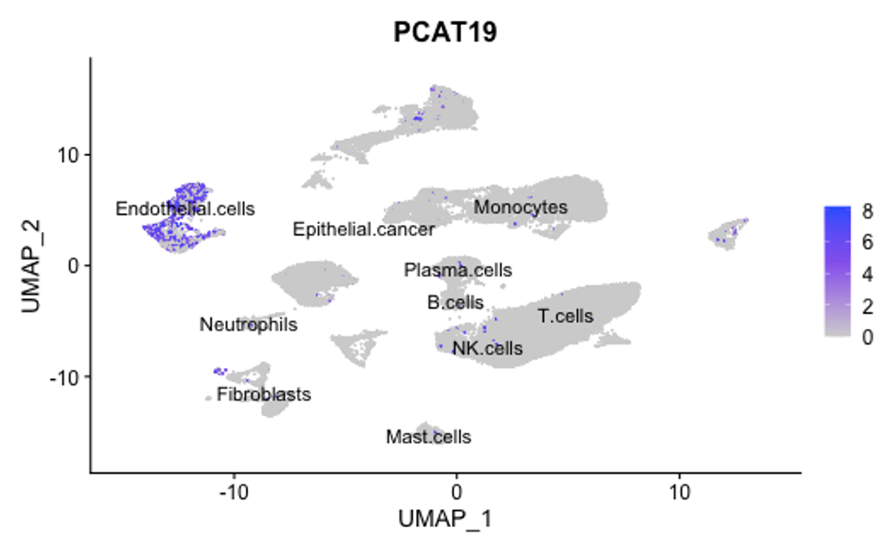
PCAT19 activates a subset of cell-cycle genes associated with PCa progression, thereby promoting PCa tumor growth and metastasis
(Cell -- Hua et al., 2018)

Slide 27
Despite discovering thousands of lncRNAs, only a minor subset have been well characterized
(Nature Reviews Cancer Liu et al., 2021)

Slide 28
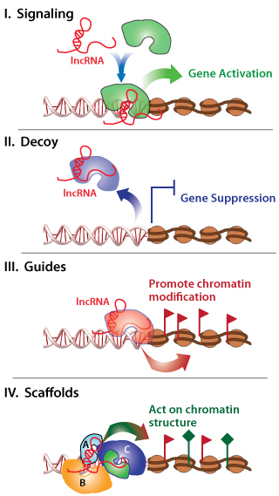
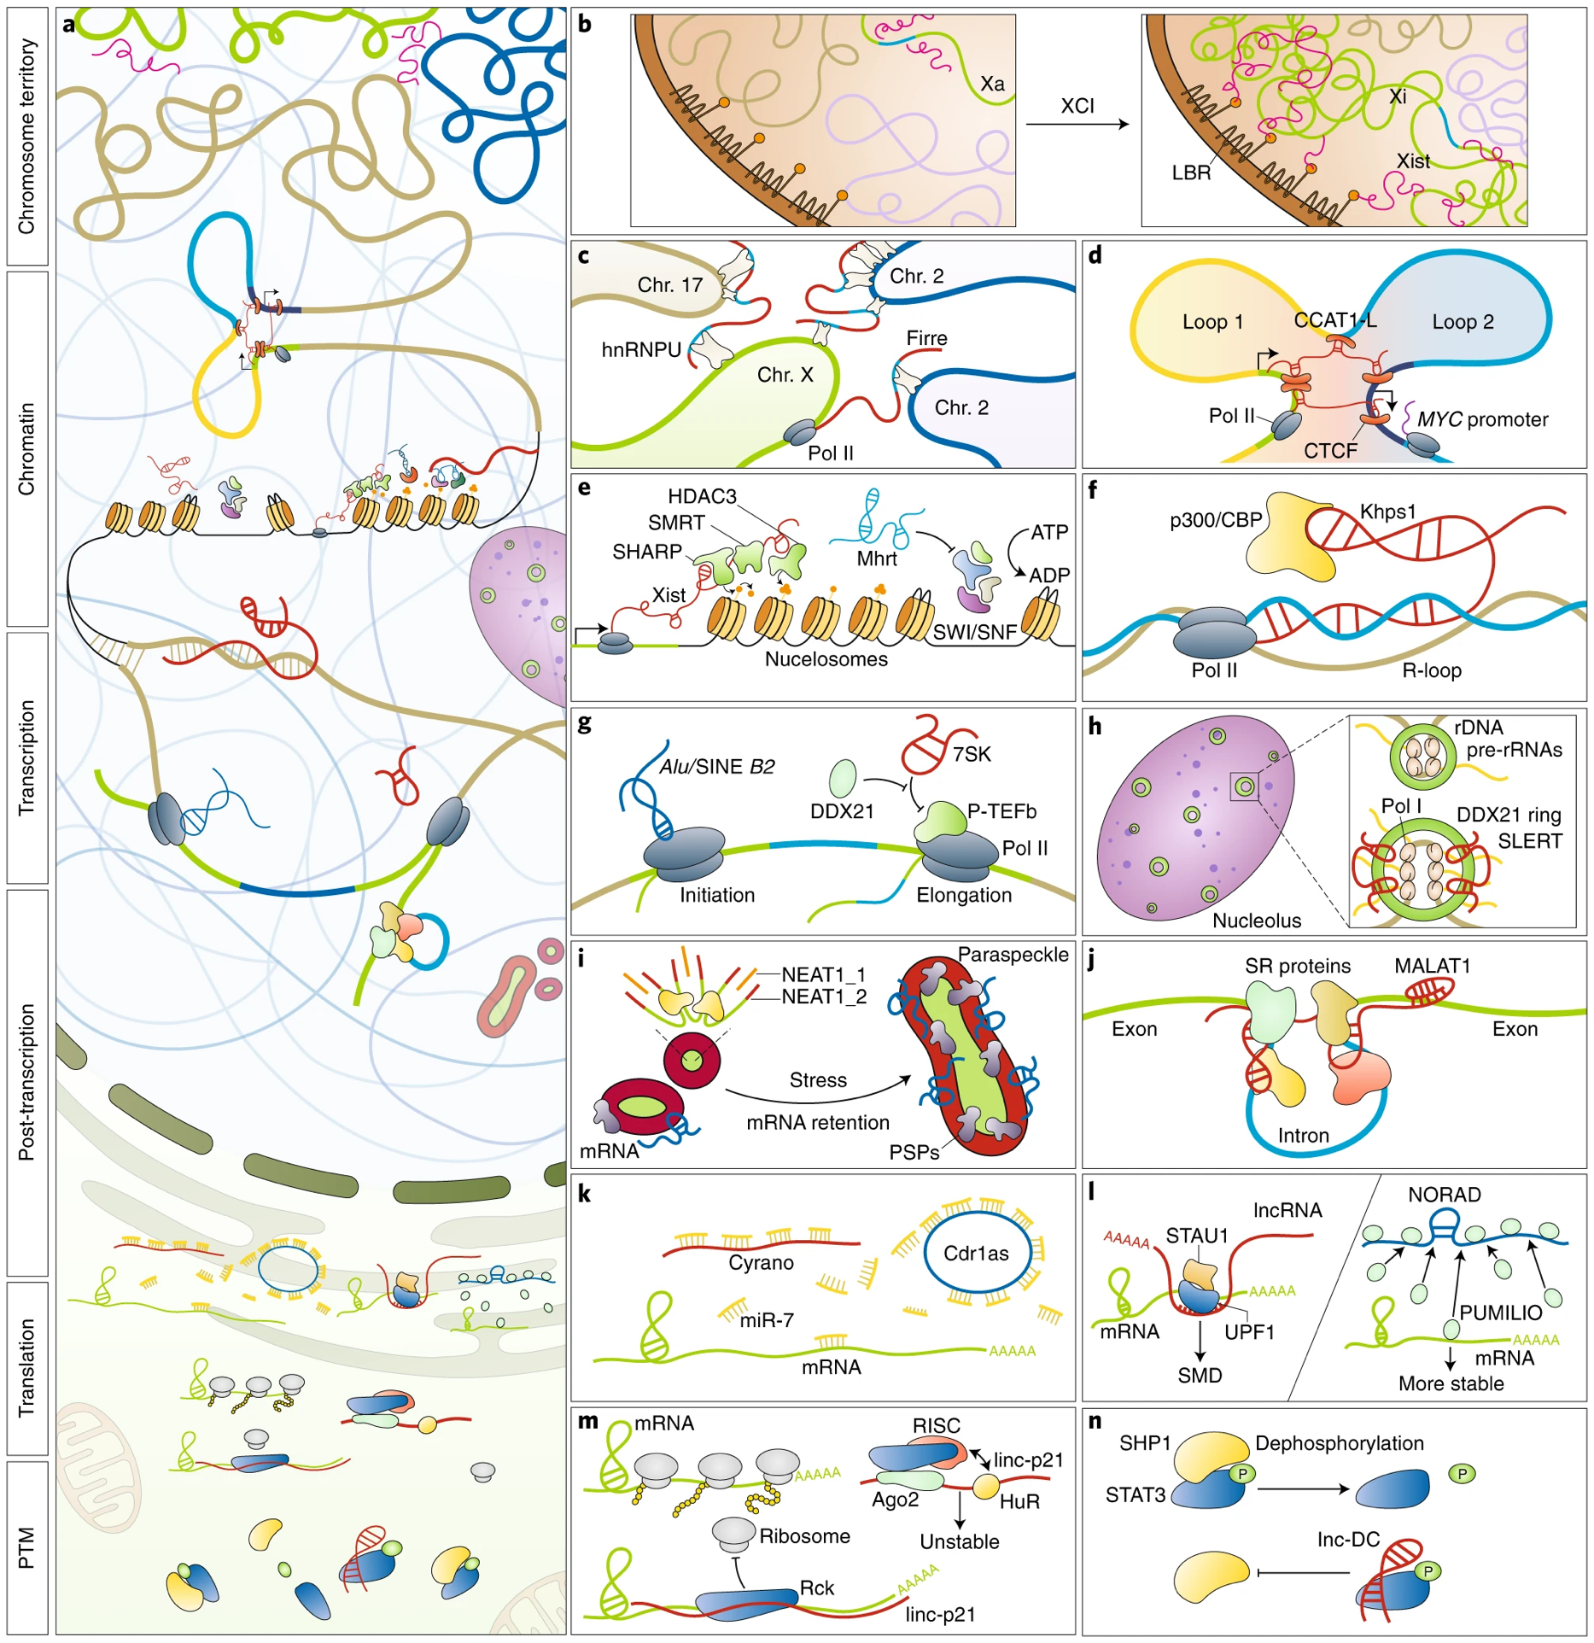
Putative lncRNA regulatory mechanisms
Notes:
a, A snapshot of cellular functions of lncRNAs with examples shown in b–n. b, Xist modulates inactive X chromosome (Xi) architecture during X chromosome inactivation (XCI) by recruiting Xi to associate with the lamin B receptor (LBR) at the nuclear lamina to silence transcription. c, Firre transcripts localize to their transcription site and five additional autosomal chromosomal loci in trans to affect interactions between distant genomic regions. d, CCAT1-L accumulates in cis to modulate chromatin loops between enhancers and the promoter of MYC. e, lncRNAs regulate chromatin accessibility. Left, Xist recruits HDAC1-associated repressor protein (SHARP), silencing the mediator for retinoid and thyroid hormone receptor (SMART) and HDAC3 to silence Xi. Right, Mhrt prevents SWI/SNF binding to corresponding DNA loci. f, Khps1 enhances Pol II transcription by forming an R-loop that anchors Khps1-interacting p300/CBP to the SPHK1 promoter. g, lncRNAs interfere with Pol II transcription machineries both at the initiation (left) and elongation (right) stages. h, SLERT promotes Pol I transcription by binding DDX21 to alter its conformation, thereby releasing its inhibitory effect on Pol I. i, NEAT1 is an architectural lncRNA that nucleates paraspeckles. Upon cellular stress, altered NEAT1 transcription and processing lead to changes of paraspeckles. PSP, paraspeckle proteins. j, MALAT1 interacts with SR proteins and alters their phosphorylation to impact pre-mRNA splicing in splicing speckles. k, A regulatory network consisting of different types of ncRNAs. Cyrano, harbouring miR-7 binding sites, targets miR-7 for degradation and prevents miR-7 from repressing its target RNAs including the circRNA Cdr1as. l, lncRNAs modulate mRNA stability by associating with proteins involved in mRNA degradation. Left, double-stranded RNAs formed by Alu-containing lncRNAs with mRNA 3′ UTRs recruit STAU1 to induce STAU1-mediated mRNA decay (SMD). Right, NORAD stabilizes PUMILIO 1/2 (PUM1/2)-targeted mRNAs via sequestering PUM1/2 from mRNAs. m, lncRNAs regulate translation. Association of lincRNA-p21 (linc-p21) with HuR favours the recruitment of let-7/Ago2, leading to its destabilization. In the absence of HuR, lincRNA-p21 identifies mRNA targets to repress their translation by recruiting the translation repressor Rck¹²⁹. RISC, RNA-induced silencing complex. n, lncRNAs modulate post-translational modifications. Lnc-DC directly interacts with STAT3 to prevent its dephosphorylation by SHP1.

Slide 29
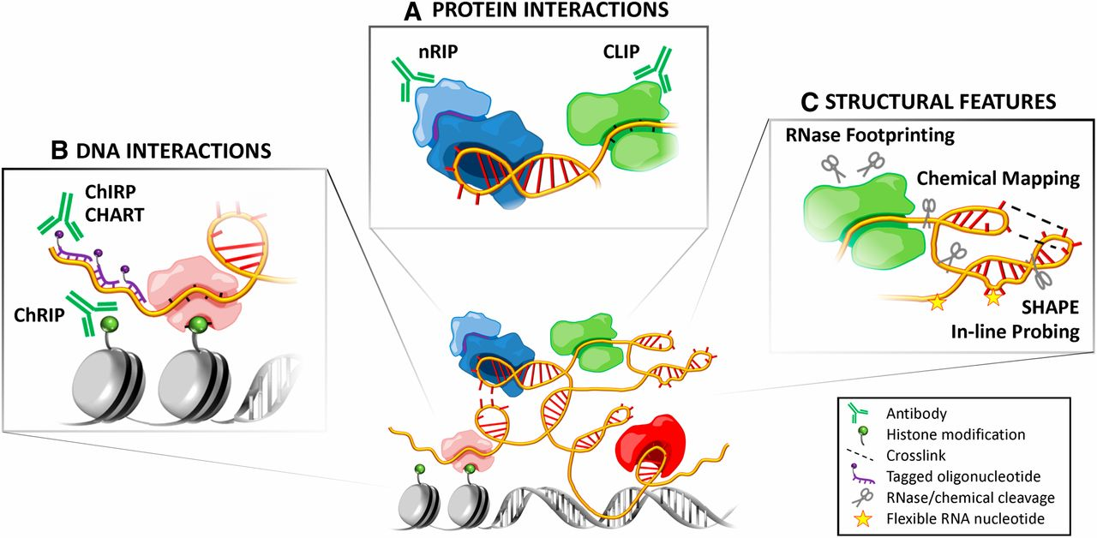
Our ability to understand how a lncRNA functions requires knowledge of its interacting partners: DNA, RNA, and/or protein
Notes:
Methods for studying lncRNAs. (A) Protein interactions: Identifying protein partners of lncRNAs provides clues into their functional mechanisms and pathways. RNA-immunoprecipitation (RIP) techniques such as chemical-cross-linked RIP (Selth et al. 2009), native RIP (nRIP) (Zhao et al. 2008), and UV-crosslinked immunoprecipitation (CLIP) (Ule et al. 2005) use antibodies to pull down ribonucleoprotein complexes, from which the associated RNAs are isolated for analysis. Each variation has its own advantages and disadvantages: nRIP avoids cross-linking artifacts, whereas CLIP may be better at avoiding reassociation artifacts and can be used to identify protein-interacting regions (even nucleotides) of the RNA. These techniques are being combined with high-throughput sequencing (e.g., RIP-Seq, HITS-CLIP/CLIP-Seq) to identify lncRNA interactions with a whole host of protein factors (Licatalosi et al. 2008; Zhao et al. 2010), although further validation by mechanistic studies is required. (B) DNA interactions: Several techniques have been developed to identify the genomic targets of lncRNAs. Based on principles of both chromatin immunoprecipitation (ChIP) and RIP, chromatin RNA immunoprecipitation (ChRIP) can be used to identify RNAs associated with a particular chromatin mark (Pandey et al. 2008). On the other hand, techniques such as chromatin oligo-affinity precipitation (ChOP) (Mariner et al. 2008), chromatin isolation by RNA purification (ChIRP) (Chu et al. 2011), and capture hybridization of RNA targets (CHART) (Simon et al. 2011) use tagged complementary oligonucleotides to identify DNA loci that interact with an RNA of interest. (C) Structural features: ncRNAs form specific secondary (base pairing) and tertiary (three-dimensional) structures to carry out their functions. Such structures can be mapped using chemical reagents that cleave at specific nucleotides or attack solvent-exposed regions of the RNA backbone or by cross-linking three-dimensionally proximal regions of the RNA to reveal long-range intramolecular interactions (Weeks 2010). Ribonucleases with different cleavage specificities are also used to identify single- or double-stranded regions, as well as protein-protected regions (RNase footprinting). Other methods such as selective 2′-hydroxyl acylation analyzed by primer extension (SHAPE) (Wilkinson et al. 2006) and in-line probing (Regulski and Breaker 2008) assess local nucleotide flexibility. SHAPE has since been adapted for high-throughput analysis (SHAPE-Seq) (Lucks et al. 2011), joining other techniques that rely on RNase digestion such as fragmentation sequencing (FragSeq) (Underwood et al. 2010) and parallel analysis of RNA structure (PARS) (Kertesz et al. 2010).

Slide 30
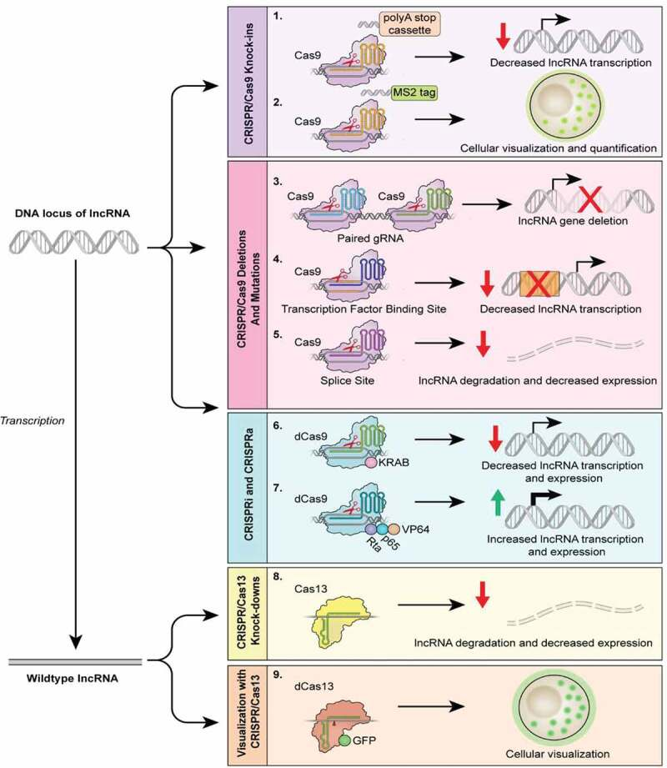
CRISPR based strategies are dependent on the proposed functional mechanism
Notes:
The CRISPR/Cas9 technology can be used to target various regions within a lncRNA gene, manipulating the lncRNA expression to gain functional insights. The CRISPR/Cas9 technology can be used to produce knock-in phenotypes (1,2), inserting a polyA stop cassette downstream of the transcription start site to decrease transcription or to encode a MS2 tag, as used in the CERTIS system, to localize lncRNAs. Additionally, the Cas9-gRNA complex can be directed to the beginning and end of the locus (3), splice sites (5), as well as transcription factor binding sites within the promoter region (4). These techniques will likely result in the partial or complete reduction of lncRNA levels within a cell. CRISPR activation, CRISPRa (7), and CRISPR interference, CRISPRi (6), can be used to overexpress or silence lncRNA expression via catalytically dead Cas9 (dCas9) without permanent genomic editing. CRISPRa employs a dCas9-gRNA complex fused with transcription activators (i.e. VP64, p65, and Rta) to robustly activate the transcription of the lncRNA gene. Conversely, the transcription of a lncRNA gene can be inhibited by CRISPRi, which utilizes a dCas9-gRNA complex fused with KRAB, a transcription repressor. Various orthologs of Cas13 can be utilized in lncRNA knockdown (8) in which a gRNA targets catalytically active Cas13 to single-stranded lncRNAs, leading to degradation of the molecule. Cas13 can also be used to visualize lncRNAs (9) by fusing dCas13 to a fluorescent protein

Slide 31
A LncRNA-Centric Approach

Slide 32
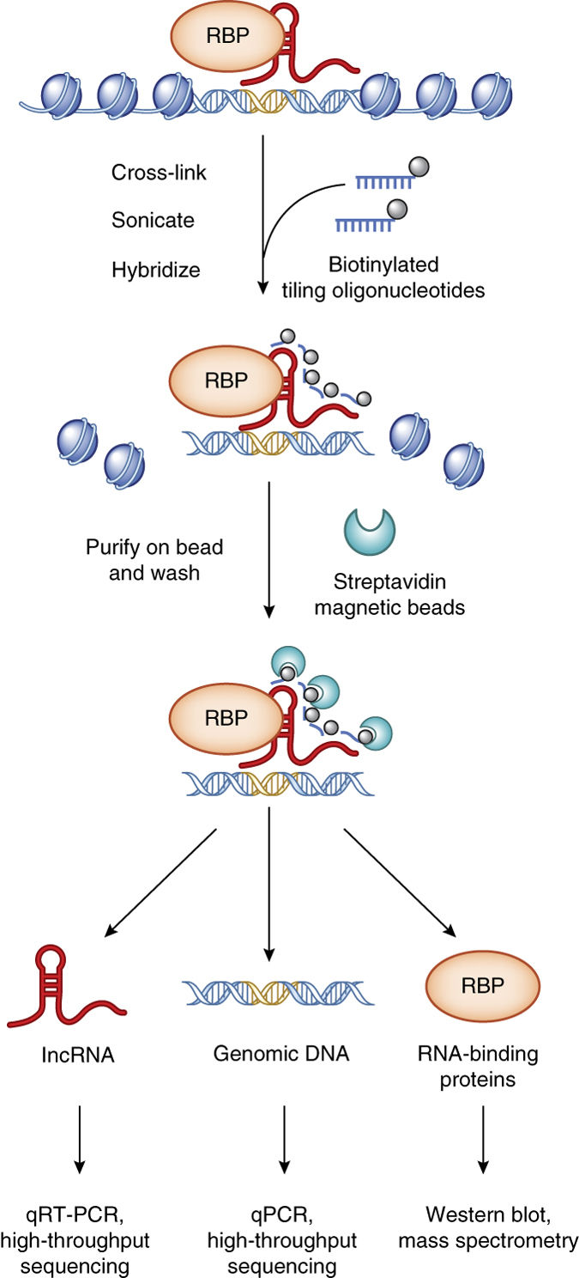
Elucidating lncRNA interactions with proteins, RNA, and DNA
ChIRP (chromatin isolation by RNA purification)
RNA–protein–DNA complexes are cross-linked in vivo and solubilized by sonication
Biotinylated tiling oligonucleotides are hybridized to target lncRNAs
Oligonucleotide-bound RNA and associated complexes are efficiently pulled down with streptavidin magnetic beads
Enriched RNA, protein and DNA can be isolated and subjected to downstream analysis
(Chu et al., 2014)

Slide 33
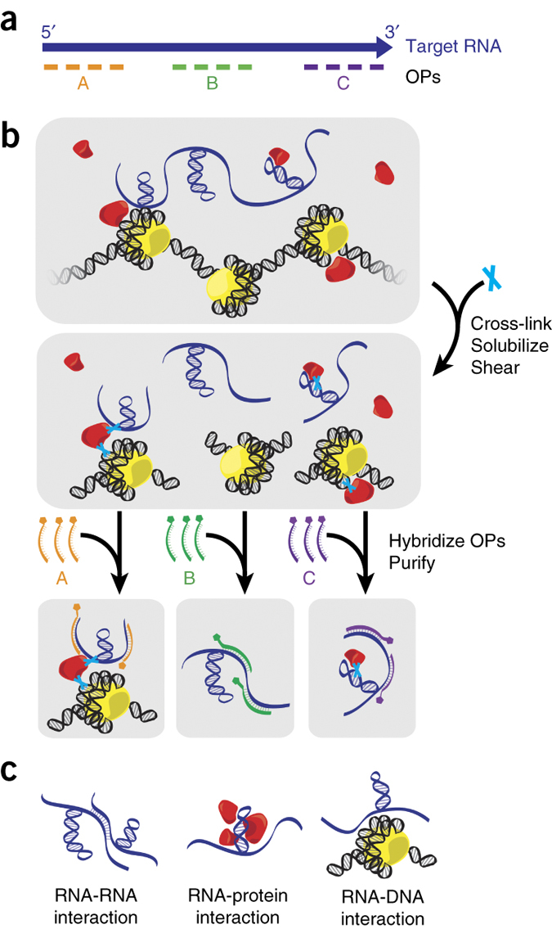
Mapping functional domains within lncRNAs
Domain Specific ChIRP (dChIRP)
(Chu et al., 2011; Quinn et al., 2014)

Slide 34
Additional methods to interrogate lncRNA interactions

Slide 35
Methods are more similar than different
Approach | Probe | Pros | Cons
ChIRP | 20-nt; unbiased | Probes are cheap and have minimal off-target effect | Irrelevant probes increase noise
dChIRP | 20-nt; unbiased | Improve signal-to-noise by reducing probes | Requires more independent experiments
RAP | 120-nt; unbiased | High specificity of longer probes | Probes cost more to synthesize
CHART | Rnase H assay to narrow search space | Background signal reduced due to relatively few probes used | RNase Assay only indicates a probe can bind, not chromatin interaction; time consuming

Slide 36
What have these methods revealed?
LncRNAs do not follow any single paradigm in their regulation
General characteristics
Focal or broad binding
Cis or trans regulation
Relatively few to thousands of binding sites
Activation and Repression
3D conformation dependent

Slide 37
A Protein-Centric Approach

Slide 38
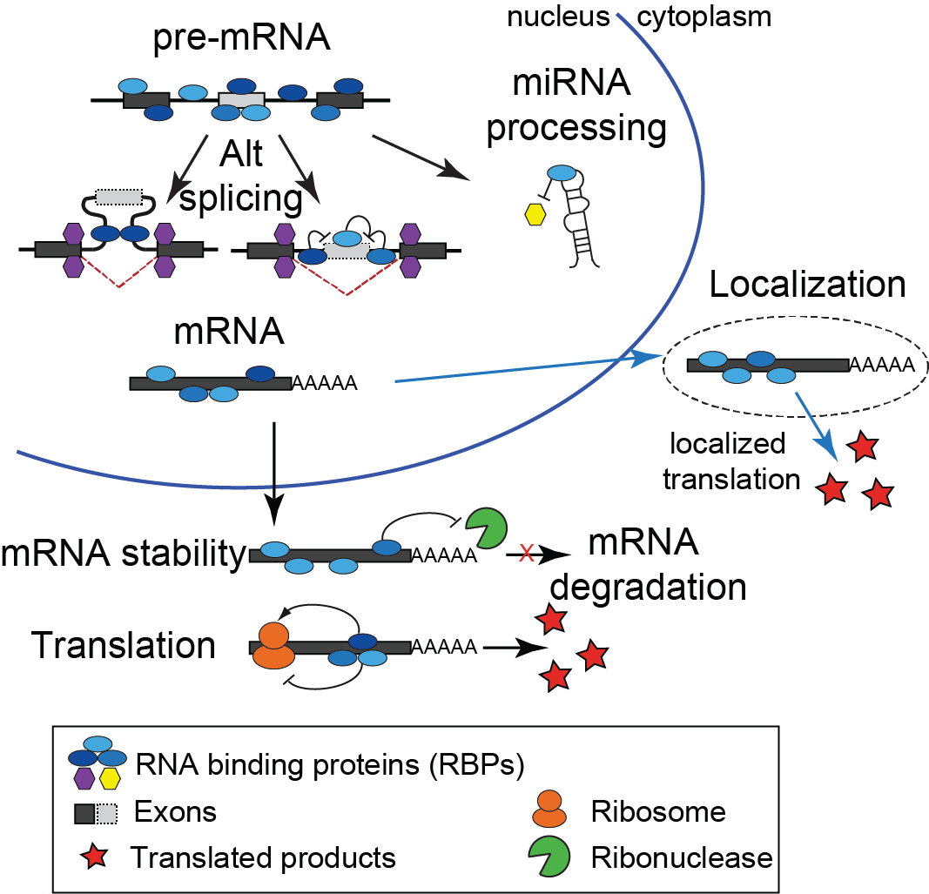
RNA Binding Proteins (RBPs)
Estimated >1000 RBPs in human
Have diverse roles in post-transcriptional gene expression, including regulation of alternative splicing, RNA export and localization, RNA stability and translation
Functionality in gene regulation is naturally dependent on their ability to selectively recognize and bind target RNAs within the cell
Mutation or alteration of RNA binding proteins plays critical roles in disease

Slide 39
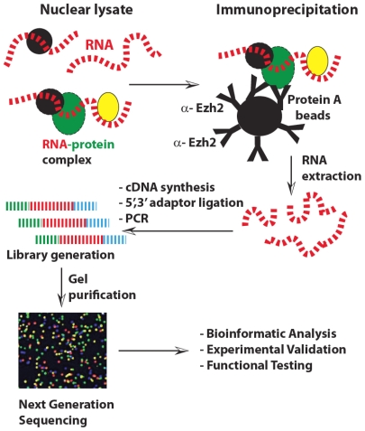
RNA Immunoprecipitation coupled with NGS (RIP-Seq)
RIP allows identification of the target RNA molecules binding to an RBP
Limitations
Data may include indirectly bound sequences
High variability
Requires high quality antibody
Precise locations of the binding site on the target mRNA may be difficult to determine
RIP conditions must be calibrated to minimize reassociation of RBPs with mRNA in vitro after cell lysis

Slide 40
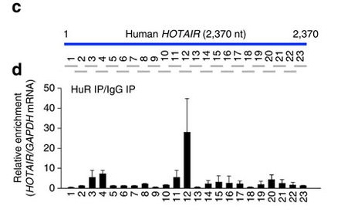
Locating specific interaction sites
RNAse protection assay can help localize the potential interaction site
(Yoon et al., 2013)

Slide 41
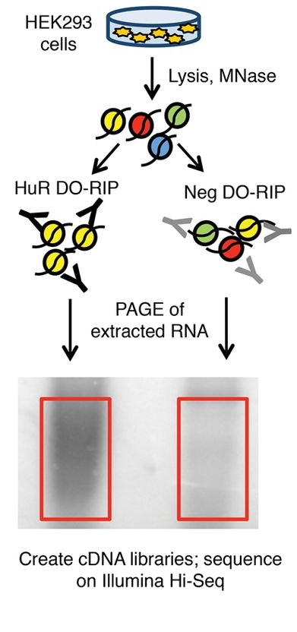
DO-RIP-Seq Overview
Cell lysates treated with micrococcal nuclease (MNase) under optimized conditions to partially digest RNA to fragments bound by the RBP.
RNAs from parallel immunoprecipitations using a nonspecific control antibody or similar negative sample were extracted for normalization of the positive sample
(RNA -- Nicholson et al. 2017)
Notes:
(A) A schematic representation of DO-RIP-seq procedure. (MNase, micrococcal nuclease; HuR DO-RIP, DO-RIP done with antibodies against HuR; NEG DO-RIP, negative control DO-RIP with nonspecific antibodies; PAGE, polyacrylamide gel electrophoresis.) (B) Optimization of MNase digestion using immunoprecipitated HuR RNPs. Various amounts of MNase (across the top: gel units of MNase/µg total RNA) were tested (nt, nucleotides). The green rectangle demarcates the preferred conditions; in this case between 73 and 18 gel units of MNase per µg total RNA. (C) RNA fragments after MNase digestion of cell lysates from three biological replicates of HuR (HuR.1/.2/.3) and negative control (Neg.1/.2/.3) DO-RIPs. The boxes demarcate the region of each gel from which RNA was extracted and used to prepare cDNA libraries for sequencing. (D) Comparison of PAR-CLIP-seq (Friedersdorf and Keene 2014) and DO-RIP-seq transcriptome coverage derived from cDNA libraries of immunoprecipitated HuR and Neg based on fragments per thousand per million (FPKM). ([NPC] negative control PAR-CLIP, [HPC] HuR PAR-CLIP, [NDR] negative control DO-RIP-seq, [HDR] HuR DO-RIP-seq). (E) Comparative matrix of R-correlation values for the number of aligned reads at 5-nt intervals of three replicates of HuR and Neg DO-RIP-seq libraries.

Slide 42
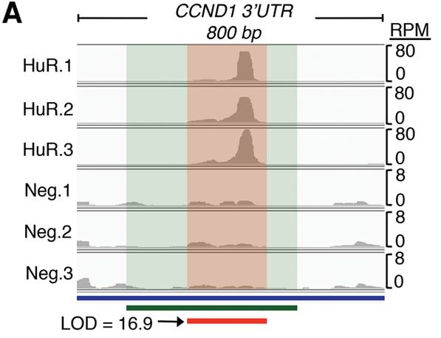
DO-RIP-Seq detects validated interaction sites
HuR DO-RIP-seq binding site (red bar and shading) in the CCND1 mRNA 3′UTR in comparison to the binding site deduced by a previous study (green bar and shading) using deletion analysis (Lal et al. 2004).
Cindo O. Nicholson et al. RNA 2017;23:32-46
Notes:
(A) HuR DO-RIP-seq binding site (red bar and shading) in the CCND1 mRNA 3′UTR in comparison to the binding site deduced by a previous study (green bar and shading) using deletion analysis (Lal et al. 2004). The log of odds score (LOD) and read depth in reads per million (RPM) are depicted. (B) A comparison of the abundance of HuR binding sites in locations across the transcriptome ([3′UTR] 3′ untranslated region, [5′UTR] 5′ untranslated region, [CDS] coding sequence exons, [ncRNA] noncoding RNA). (C) Sequence logo of the most frequently observed cDNA nonamer in HuR binding sites. (D) CDF plot comparing log₂ fold-change in mRNA expression following HuR siRNA knockdown for HuR targets identified by DO-RIP-seq, PAR-CLIP, both, or neither. A rightward shift in the curves suggests a greater proportion of regulated targets because HuR is proposed to generally stabilize mRNAs. Targets identified in both techniques (DO-RIP-seq and PAR-CLIP) appear to identify the largest proportion of regulated targets, while targets only identified by DO-RIP-seq (not PAR-CLIP) outperform targets only identified by PAR-CLIP (not DO-RIP-seq) or not identified as targets by either technique. siRNA data are from Mukherjee et al. (2011). (E) HuR binding site saturation analysis. The fractions of significantly enriched (P-value < 0.05) HuR binding sites were plotted for different percentages (10%, 30%, 50%, 70%, and 90%) of random sampled HuR DO-RIP reads. Black line indicates expected trend for completely unsaturated set. Colored points indicate the fraction of binding sites with LOD scores greater than the associated value. (F) Cumulative percentage of all HuR binding sites for sites with LOD scores greater than associated value. Colors match colors from panel E to indicate the cumulative percentage for each saturation curve. (G) Area under the curve analysis testing how well site accessibility predicts binding by HuR comparing DO-RIP or PAR-CLIP data. Red line is DO-RIP-Seq, blue line is PAR-CLIP, and dashed green line is x = y.

Slide 43
Methods to capture protein-RNA interactions
(Wheeler et al., 2017)
Notes:
FIGURE 1 | Methods to capture protein–RNA interactions. Different techniques are required to capture single-stranded (green), doublestranded
(blue), and indirect (yellow) RNA interactions. Crosses (X) in red mark RNA sites that are crosslinked to the RNA binding protein. Right:
UV treatment at 254 nm preferentially captures binding in single-stranded regions. Bottom right: 0.1% formaldehyde treatment captures all
protein–protein and protein–RNA interactions. Bottom left: RNA immunoprecipitation (RIP) uses a native pulldown (no crosslinking) to capture
binding events with antibody selection. Optimized RNA digestion conditions can reveal specific binding sites with RIP. Left: Photoactivatable
ribonucleoside (PAR) analog treatment increases UV crosslinking efficiency at 365 nm. Top left: Methylene blue intercalates between the bases of
double-stranded RNA to allow crosslinking in double-stranded regions in the presence of visible light. Top right: Protein–RNA interaction sites are
marked by exogenous RNA modifications. This requires creating a fusion protein to modify RNA near binding sites with biotinylation (BioTag-BirA)
or A-to-I RNA editing (ADAR).

Slide 44
Common variations of crosslinking immunoprecipitation (CLIP)
HITS-CLIP 254 nm ultraviolet UV cross-linking and immunoprecipitation allows more stringent washing and RNase treatment of bound RNAs
PAR-CLIP is another modification of CLIP-seq that first treats the cell with a modified nucleoside (4SU or 6SG), which is incorporated into transcribed RNA. The modified nucleotide can be cross-linked using longer wavelength UV radiation
iCLIP identifies binding sites more precisely by taking advantage of the fact that the amino acid tag left by proteinase K treatment terminates reverse transcription The truncated cDNA molecules can be marked with cleavable adaptor and barcode allowing for self circularization
(Nature Reviews Genetics – Konig et al., 2012)
Notes:
Figure 3: In vivo methods for determining RBP targets. ( A) RIP-chip and RIP-seq determine bound RNAs by analyzing immunoprecipitated RNPs by microarrays or high-throughput sequencing. ( B) UV cross-linking and immunoprecipitation allows more stringent washing and RNase treatment of bound RNAs. iCLIP identifies binding sites more precisely by taking advantage of the fact that the amino acid tag left by proteinase K treatment terminates reverse transcription. ( C) PAR-CLIP is another modification of CLIP-seq that first treats the cell with a modified nucleoside (4SU or 6SG), which is incorporated into transcribed RNA. The modified nucleotide can be cross-linked using longer wavelength UVradiation.
Comparison of HITS-CLIP and its latest variants, PAR-CLIP and iCLIP. For high-throughput sequencing of RNA isolated by ultraviolet (UV) crosslinking and immunoprecipitation (HITS-CLIP), living cells or tis- sue samples are irradiated with UV light at a wavelength of 254 nm (shown in the centre of the figure). This induces the formation of covalent crosslinks between proteins and RNA, which are restricted to sites of direct contact. The cells are then lysed and RNA is partially digested to an approximate length of 30–50 nucleotides. Next, the protein–RNA complex is immunoprecipitated with an antibody that is specific for the protein of interest. After stringent washing, the RNA is radioactively labelled and an adaptor is ligated to the 3′ end of the RNA. Further puri- fication is achieved through denaturing gel electrophoresis and transfer to a nitrocellulose membrane, which removes nonspecific RNAs. The radioactive label on the RNA is used to guide the excision of the protein– RNA complex from the membrane. The protein is then removed from the RNA by proteinase K digestion. An adaptor is ligated to the 5′ end,
the RNA is reverse transcribed, and the resultiNngatcuDreNRAesvaierwe sPC| GReanmetpiclis- fied with primers that are complementary to the 5′ and 3′ adaptor regions. The resulting cDNA library is subjected to high-throughput sequencing. For photoactivatable ribonucleoside-enhanced CLIP (PAR- CLIP) (shown on the left of the figure), cells are fed with 4-thiouridine, which becomes incorporated into newly transcribed RNA. This allows crosslinking with UV light at 365 nm. During reverse transcription, the nucleoside analogue causes a base transition that can be used to pin- point the crosslinked nucleotide. In the individual nucleotide resolution CLIP (iCLIP) protocol (shown on the right of the figure), crosslinking is carried out as in HITS-CLIP at 254 nm. However, in order to capture cDNAs that truncate at the peptide that remains at the crosslinked nucle- otide after proteinase K digestion, the 5′ adaptor is added after reverse transcription. This is achieved through priming reverse transcription with an oligonucleotide that contains the 3′, as well as the 5′, adaptor region followed by circularization of the generated cDNAs.

Slide 45
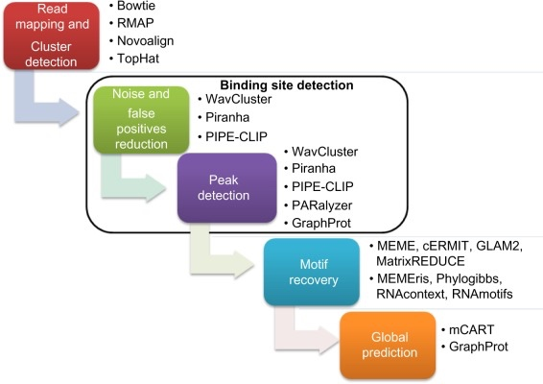
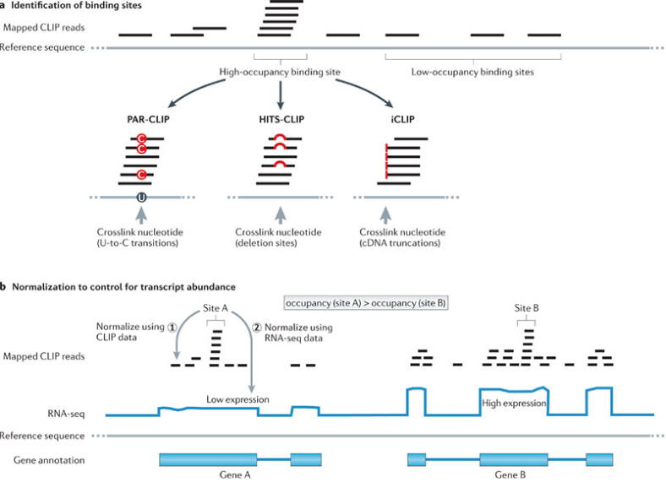
CLIP-Seq data analysis workflow

Slide 46
How do you choose?
(Barra et al., 2017)

Slide 47
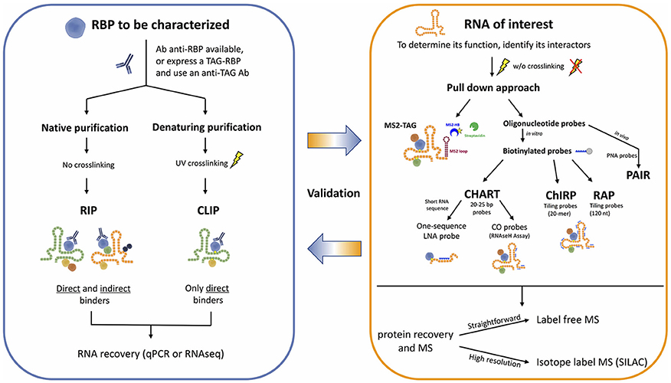
Integration of various strategies

Slide 48
LncRNA summary
LncRNAs are an abundant class of biologically and clinically relevant class of genes with a broad range of functionality
Despite the rapid emergence of lncRNAs, the methods to interrogating their regulatory mechanisms are still evolving
Ongoing development is still necessary to fully understand the limitations and biases of existing NGS applications and the corresponding computational tools for analysis and interpretation
Integration of orthogonal strategies will increase the likely of uncovering real lncRNA regulatory mechanisms
(Chu et al., 2015)

Slide 49
Circular RNAs

Slide 50
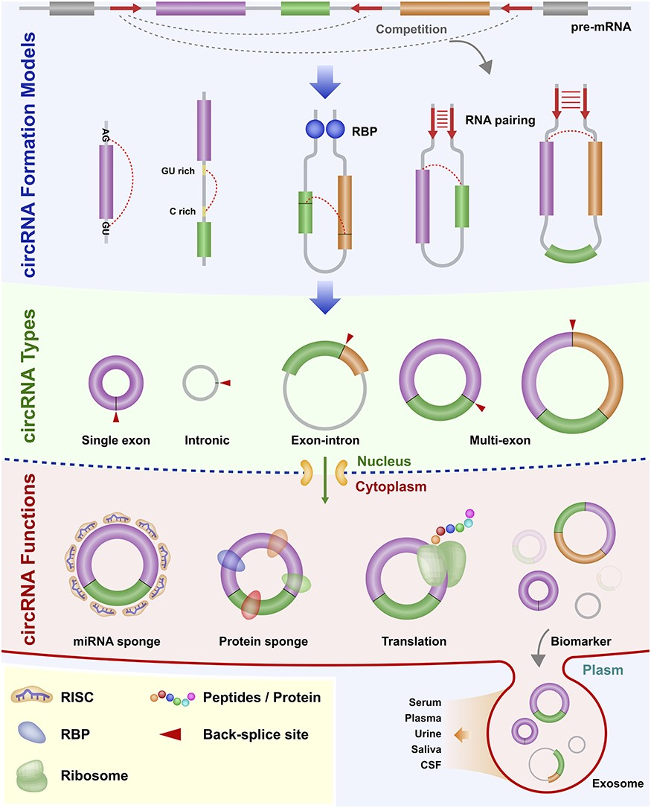
Circular RNAs (circRNAs)
(Chen et al., 2021)
Notes:
Figure 2 Biogenesis of circRNA in animal. CircRNA formation models: the back-splicing circularization requires the help of the both-end motif (Flanking AG-GU), complementary sequences (ALU elements) or RBPs. circRNA types: single exon, intronic, exon-intron and multi-exon. circRNA functions: miRNA sponge, protein sponge, translation and biomarker. Abbreviations: cerebrospinal fluid, CSF; RNA-induced silencing complex, RISC; RNA-binding protein, RBP.
Unless provided in the caption above, the following copyright applies to the content of this slide: © The Author(s) 2020. Published by Oxford University Press.This is an Open Access article distributed under the terms of the Creative Commons Attribution Non-Commercial License (http://creativecommons.org/licenses/by-nc/4.0/), which permits non-commercial re-use, distribution, and reproduction in any medium, provided the original work is properly cited. For commercial re-use, please contact journals.permissions@oup.com© The Author(s) 2020. Published by Oxford University Press.

Slide 51
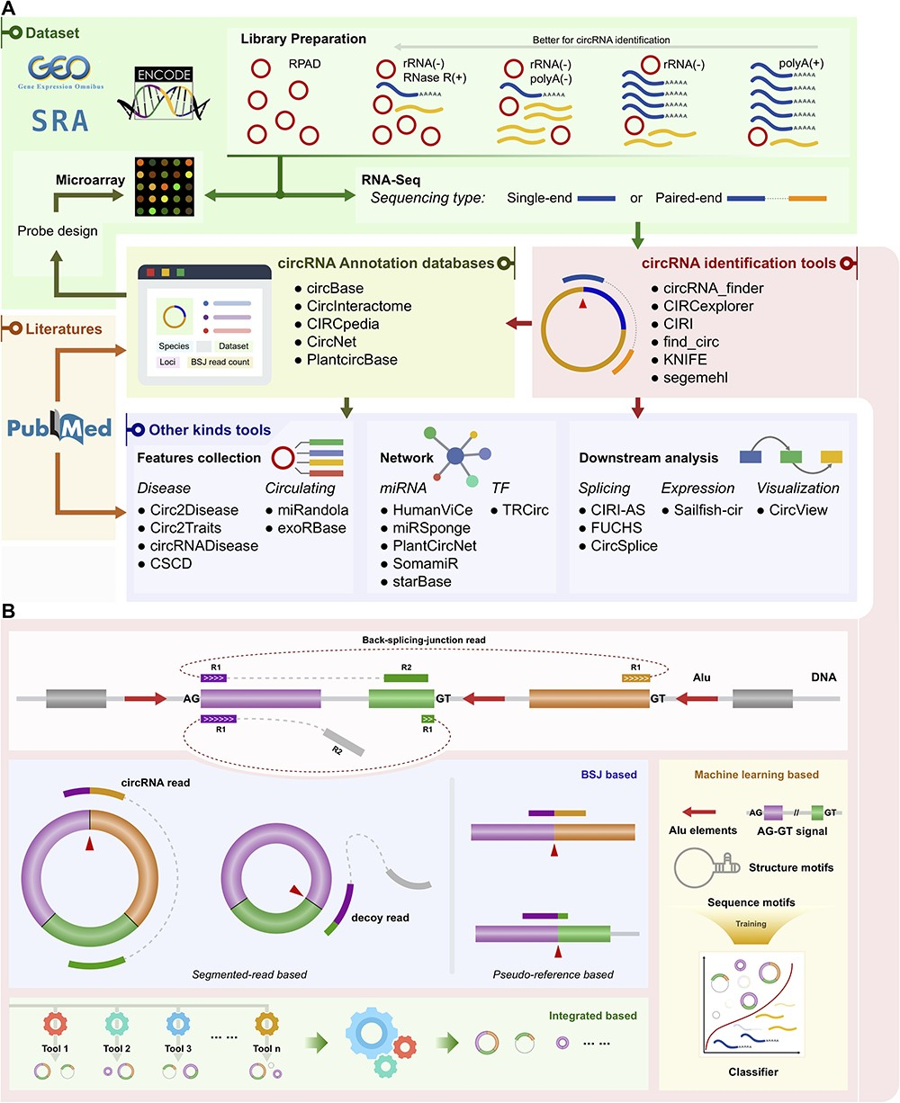
Overview of existing circRNA resources and tools
(Chen et al., 2021)
Notes:
Figure 3 Schematic of classified circRNA bioinformatics tools. (A) Schematic of classified circRNA bioinformatics tools. Examples of tools are listed for each category. polyA(+): polyA selected; polyA(−): polyA depleted; rRNA(−): rRNA depleted; RNase R(+): treated with RNase R; RPAD: RNase R treatment followed by polyadenylation and polyA(+) RNA depletion. (B) Categories of circRNA identification tools. The top is a model of BSJ read mapping to the genome. R1 and R2 represent read1 and read2, respectively, in a paired-end RNA-Seq dataset. Three illustrations of categories are shown below the model. The categories are BSJ-based, integrated-based and machine learning-based. BSJ-based can be more finely divided into two sub-classes: segmented-read based and pseudo-reference based.
Unless provided in the caption above, the following copyright applies to the content of this slide: © The Author(s) 2020. Published by Oxford University Press.This is an Open Access article distributed under the terms of the Creative Commons Attribution Non-Commercial License (http://creativecommons.org/licenses/by-nc/4.0/), which permits non-commercial re-use, distribution, and reproduction in any medium, provided the original work is properly cited. For commercial re-use, please contact journals.permissions@oup.com© The Author(s) 2020. Published by Oxford University Press.

Slide 52
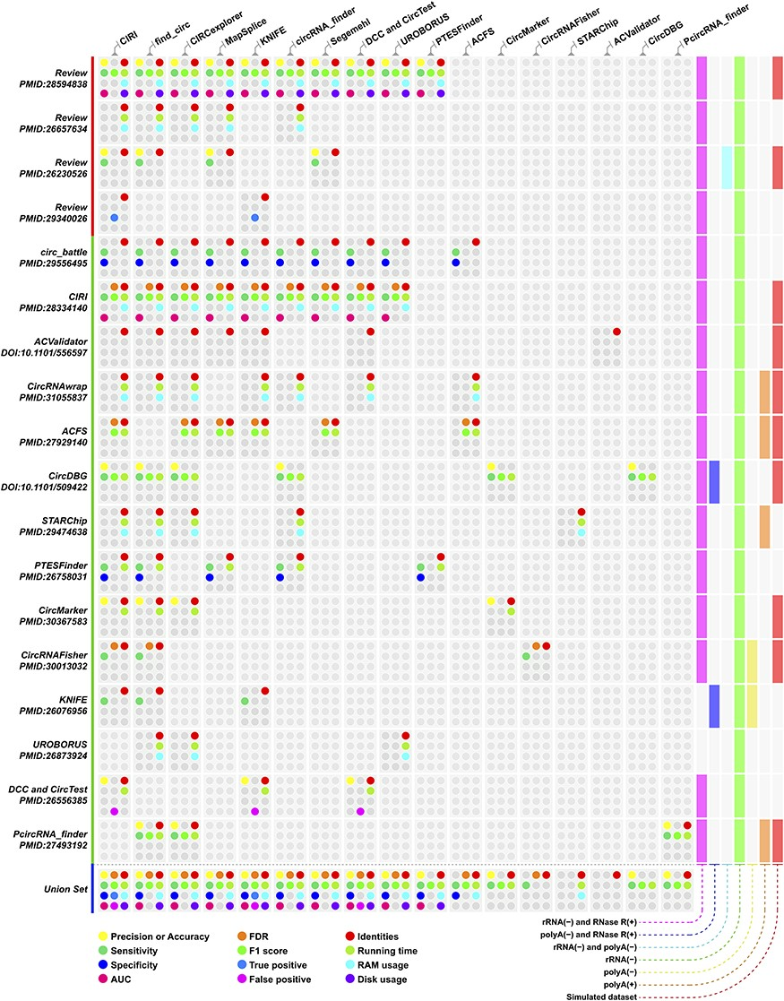
Evaluation of tools
Extensive quantity of tools available
Most existing tools are designed for short read sequencing
(Chen et al., 2021)
Notes:
Figure 4 Performance index of circRNA identification methods evaluated by different studies. The colored dot represents different performance indices, and the corresponding performance index for each dot is provided in the legend of the figure. Rows are different studies and classified by publication types, and the last row is the union set of each column. The columns represent circRNA identification tools, and the order is based on mentioned occurrences in those studies. Details regarding the dataset used in these studies are available in Supplementary Table 2.
Unless provided in the caption above, the following copyright applies to the content of this slide: © The Author(s) 2020. Published by Oxford University Press.This is an Open Access article distributed under the terms of the Creative Commons Attribution Non-Commercial License (http://creativecommons.org/licenses/by-nc/4.0/), which permits non-commercial re-use, distribution, and reproduction in any medium, provided the original work is properly cited. For commercial re-use, please contact journals.permissions@oup.com© The Author(s) 2020. Published by Oxford University Press.

Slide 53
Limited understanding of circRNAs contributing to metastatic colon cancer progression (mCRC)
Large scale studies (i.e., TCGA) mostly used poly-A selection
No standard RNA quantification method
Cell lines or limited patient cohorts
Lack of genome-wide systematic analysis
Existing databases lack inclusion of CRC (and particular matched patients throughout progression)
MiOncoCirc, a cancer focused database, contains only 14 CRC out of 880 patients
Notes:
Lymph nodes = local disease

Slide 54
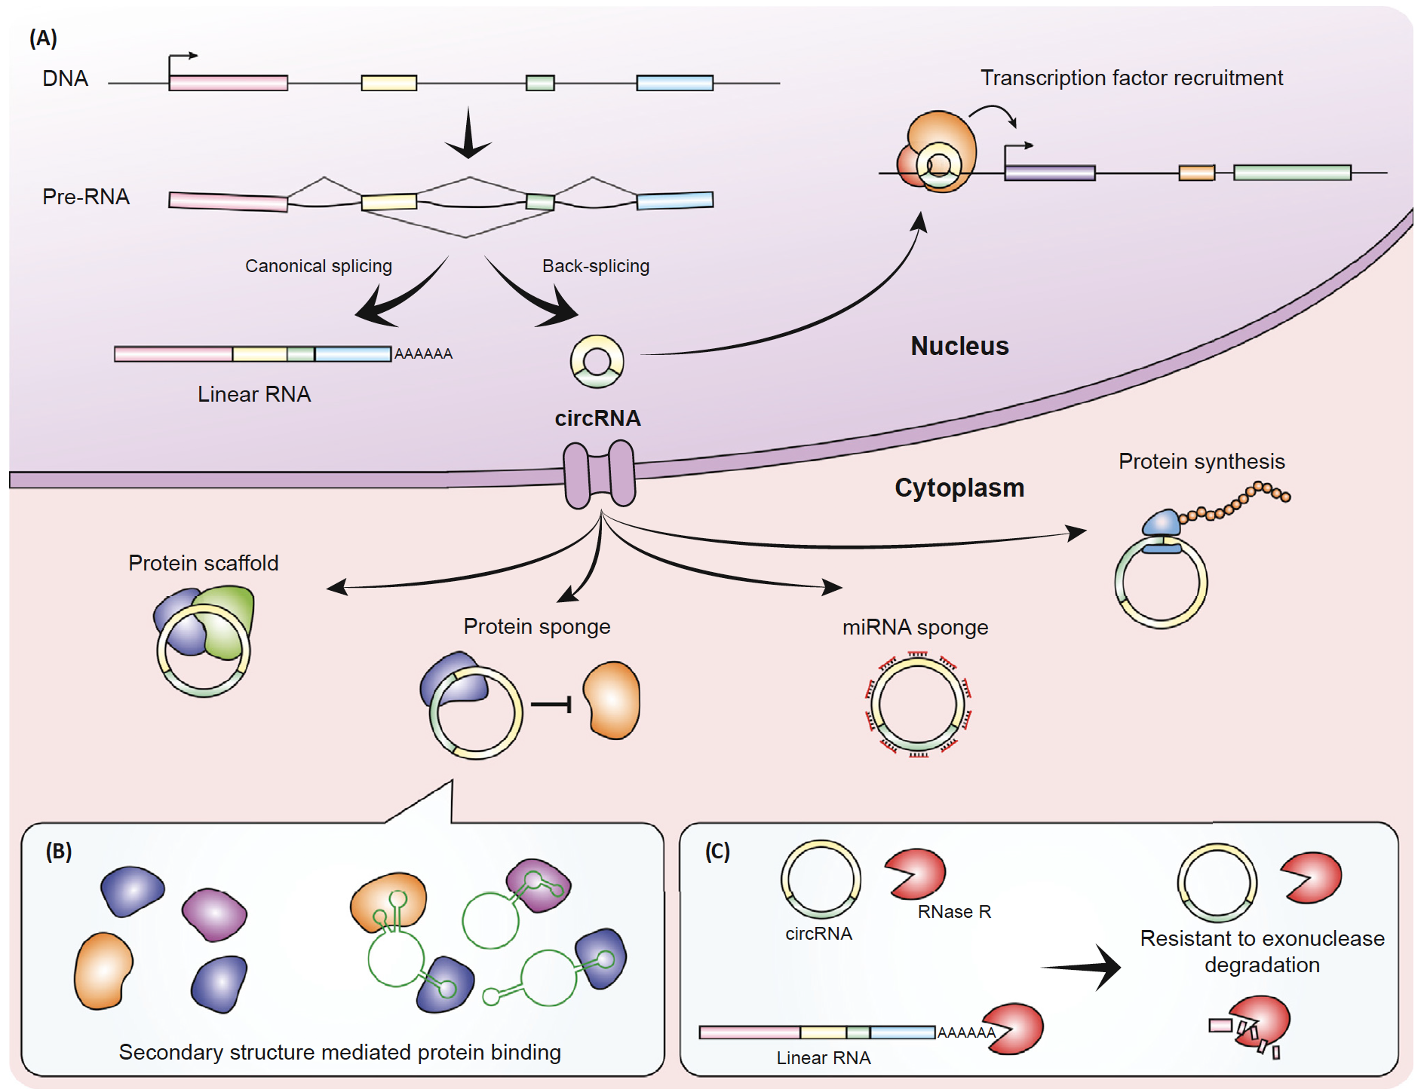

Putative functions of circRNAs remain under-studied in cancer
Limitations of circRNA translation studies
Ribo-Seq only shows initiation of translation ≠ peptide products
Proteomics study typically discard noncoding RNAs
Under-studied
Hua, J.T., S. Chen, and H.H. He, Landscape of Noncoding RNA in Prostate Cancer. Trends Genet, 2019.
Othoum, G., et al., Pan-cancer proteogenomic analysis reveals long and circular noncoding RNAs encoding peptides. NAR Cancer, 2020.
Notes:
add wellknown underappreciated examples of peptides

Slide 55

Pan-cancer proteogenomic integration of circRNAs: PepTransDB
Clinical Proteomic Tumor Analysis Consortium (CPTAC)
https://www.maherlab.com/peptransdb
(Othoum et al., 2020)

Slide 56

Possible types of peptides encoded by circRNAs
PepTransDB:
Total: 3238 peptides from 2834 circRNAs
Junction: 2010 peptides from 1964 circRNAs
(Othoum et al., 2021)
Notes:
The predominant strategy for systematically identifying annotated noncoding RNAs that may encode small peptides is high-throughput ribosomal profiling. However, this approach is limited since ribosome occupancy does not necessarily confirm active translation but may be a mere indicator of translation initiation^{[22]}. Further, the presence of translatable ORFs in circRNAs (cORFs) has been shown to play a role in cancer development, but the computational tools used to predict whether or a circRNA can potentially translate into a protein have difficulty detecting cORFs that are unique to the circular isoforms only, i.e., not present in the linear counterparts^{[6, 7, 68-72]}. Lastly, since the body of a circRNA is also found in the parental linear transcript and the expression of the circRNA are often lower than the latter, it is technically challenging and often error-prone to derive full-length circRNA sequences directly from RNA-Seq data^{[23]}. Therefore, to achieve reliable and robust peptide identification in circRNAs, a proteogenomic integration of mass spectrometry-based proteomic data (MS/MS) and transcriptome sequencing data that encompass the annotation of the full lengths of circRNAs is needed.

Slide 57


Short read strategies are limited to terminal exons
E.g. CircSHPRH was missed in PepTransDB
4 exons involved (exon 26, 27, 28, 29)
Translated open reading frame (ORF) spans beyond backsplice junction (exon 29-26)
To comprehensively capture ORFs of full circular transcripts: PacBio long-read sequencing
Exon 26
Exon 29
Notes:
circSHPRH: exon 26-29, our sequence is only 174 nt whereas their orf is 440nt

Slide 58


CircRNA detection using short-read analysis pipeline
CRC Cell Line HCT116
AAAAAAA
RNA Transcripts
1.
Exon Enrichment
cDNA-Capture
2.
*DNA Probe
Short-Read RNA-Seq
3.
STAR
5’
3’
Read Alignment
Linear Mapped Reads
R1
R2
5’
3’
R1
R2
4.
5’
3’
R2
R1
Chimeric Reads
Unmapped Reads
R2
R1
Realignment
CIRCexplorer2
5’
3’
5.
R1
R2
Backsplice Junction Reads
Non-Junctional Reads
R2
R1
R2
3’
5’
R1
6.
CircRNA Discovery
(Cabanski et al., 2014)
Notes:
96% on target, 92% splice reads on target, ~4300 circRNA on average

Slide 59
CircRNA discovery with long reads
CRC Cell Line HCT116
AAAAAAA
φ29 Polymerase
RNA Transcripts
1.
CircRNA Rolling Circle Amplification
Long Read #1
5’
3’
2.
Long Read #2
PacBio Long-Read RNA-Seq
5’
3’
TRF
Repetitive
Unit
Repetitive
Unit
3.
Consensus Reads
5’
3’
5’
3’
minimap2
Realignment
Realignment
4.
Mapped Reads
5.
isoCirc
Linear Gene
Backsplice Junction Reads
*
*Non-Canonical Splice Site
6.
Isoform
#1
CircRNA Discovery
#2
Full-Length Isoforms
Unpublished

Slide 60


Long-read sequencing produces 35x circRNA enrichment and a larger proportion of high expression circRNAs
Short-read sequencing summary
Long-read sequencing summary
Type of reads | Illumina
 | No. reads | % of total reads
Total reads | 30,980,769 | 100.00%
Reads with candidate circRNAs | 16,685 | 0.054%
Type of reads | PacBio
 | No. reads | % of total reads
Total reads | 1,637,091 | 100.00%
Reads with candidate circRNAs | 34,616 | 2.11%
27.1%
~35x enrichment
40.8%
Unpublished
Notes:
Short-read (cDNA-Cap enriched total RNA):
Illumina: 16,685/30,980,769 (0.054%)
New England: 22,368/34,183,138 (0.065%)
Long-read (rRNA-/RNaseR):
Nanopore: 13,398/667,921 (2.01%)
PacBio: 34,616/1,637,091 (2.11%)
~35x increase in circRNA read ratio

Slide 61
Identified novel peptide encoded circRNAs via PepTransDB
9 different peptides, including 2 junctional peptides
10 different cancer types
Junctional peptide example:
chr | start | end | no. exons | strand | gene
15 | 80120327 | 80122800 | 3 | + | ZFAND6
15 | 80120327 | 80122800 | 2 | + | ZFAND6
G
3’
5’
https://www.maherlab.com/peptransdb-circrna

Slide 62

Higher percentage of novel circRNAs were detected via long-read sequencing
What was missing in short-read?
How can we leverage long-read data to improve short-read results?
Vo, J.N., et al., The Landscape of Circular RNA in Cancer. Cell, 2019.
Glažar, P., Papavasileiou, P., Rajewsky, N., circBase: a database for circular RNAs. RNA, 2014.
Unpublished
Notes:
*circBase is in hg19, possible loss of entries during LiftOver

Slide 63
Validation of rescued circRNAs
CircRNA Unique Identifier | isoCirc ID | Validated in Experiment | Mean Rescued Read Number
chr4|48369848|48383784|2|149,147|0,13789 | isocirc1618 | Yes | 5
chr17|82563353|82571870|2|94,63|0,8454 | isocirc1022 | Yes | 3
chr2|71355718|71370005|2|62,96|0,14191 | isocirc1214 | Yes | 2.5
chr1|23030468|23044486|2|57,62|0,13956 | isocirc47 | Yes | 1.5
chr2|171028338|171046362|2|67,89|0,17935 | isocirc1259 | Yes | 1
chr9|93471140|93516269|3|247,60,62|0,5115,45067 | isocirc2052 | Yes | 0.5
chr10|15128349|15135418|2|54,125|0,6944 | isocirc299 | No | 0.5
Backsplice junction
Forward primer
Reverse primer
3’
5’
PCR reaction
Backsplice junction
3’ Exon
5’ Exon
Expected band size: 256 (bp)
Gel purification
Forward primer
Reverse primer
Matching Sanger sequencing results with expected backsplice junction sequence
Purified PCR product
Sanger sequencing
18S
1618 (-)
1618 (+)
Unpublished

Slide 64
CircRNA conclusions
Novel, integrated long-read approach discovers beyond annotated circRNAs
Eventual improvement to rely on a single strategy
Improved bioinformatic workflow for comprehensive full-length circRNA characterization
Aid in future mechanistic studies exploring their function in cancer, such as evaluating the coding potential of circRNAs
More cell line and matched patient long-read sequencing data will help to discover circRNAs and encoded peptides in matched cancer patients

Slide 65









Acknowledgements

Slide 67

Functional roles of lncRNAs in cis
The lncRNA transcript itself regulates the expression of neighboring genes through its ability to recruit regulatory factors to the locus and/or modulate their function
The process of transcription and/or splicing of the lncRNA confers a gene-regulation functionality that is independent of the sequence of the RNA transcript
Regulation in cis depends solely on DNA elements within the lncRNA promoter or gene locus and is completely independent of the encoded RNA or its production
(Cell – Kopp et al., 2018)
Notes:
Figure 1. Functions of lncRNA Loci in Local Gene Regulation
The ability of a lncRNA locus to regulate the expression of nearby genes in cis may be attributable to sequence-specific functions of the mature lncRNA transcript
(A), may require transcription or splicing of an RNA, but the lncRNA itself is not functional (B), or may be due to DNA elements within the lncRNA promoter or gene
body that function independently of the transcribed RNA (C). Pol II, RNA polymerase II; TF, transcription factor.

Slide 68

Functional roles of lncRNAs in trans
(Cell – Kopp et al., 2018)
Notes:
Figure 2. Functions of lncRNAs in trans
(A) lncRNAs may regulate the expression of unlinked genes by interacting with promoters and enhancers, or other proteins bound to these sites, and influencing
chromatin states and RNA polymerase activity.

Slide 69

Enrichment strategies for circRNAs
(Bonizzato et al., 2016)

